Slide 1
Notes:
Join the conversation here: http://discuss.hashicorp.com

Slide 2
Terraform on Azure
Philippe Zenhaeusern
Cloud Solution Architect at Microsoft

Slide 3

What’s in the Workshop
Slides -> Challenges -> Slides -> Challenges
Workshop Repository->
https://github.com/Zenocolo/AzureTerraformWorkshop/blob/PAPCP

Slide 4
Workshop Expectations
Purpose
Why are we here?
Gives
What do you need to do?
Gets
What will get you get?

Slide 5
Agenda
Overview
Terraform Workflow
Challenge: Connecting to Azure
State, Variables, & Outputs
Challenge: AKS
Interpolations & Dependencies & Provisioners & Modules
Challenge: Count
Challenge: Modules
Challenge: Public Registry
Backend & Internal
Closeout & Questions
Notes:
Intro and Overview of IaC, Terraform, and Azure – give us a solid base to start discussing higher level topics
Lunch – Solution Discussion, Free form, whiteboard

Slide 6

Hashicorp
Company oveview

Slide 7
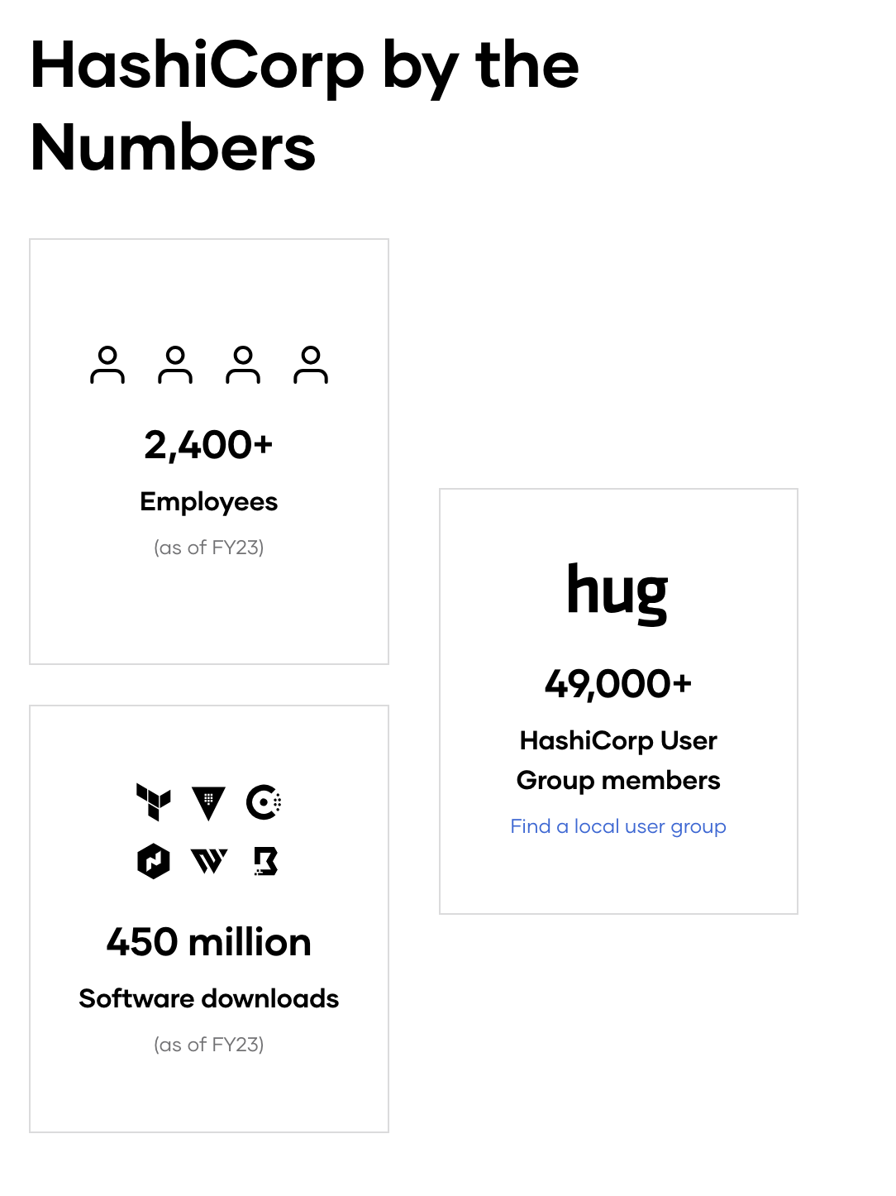
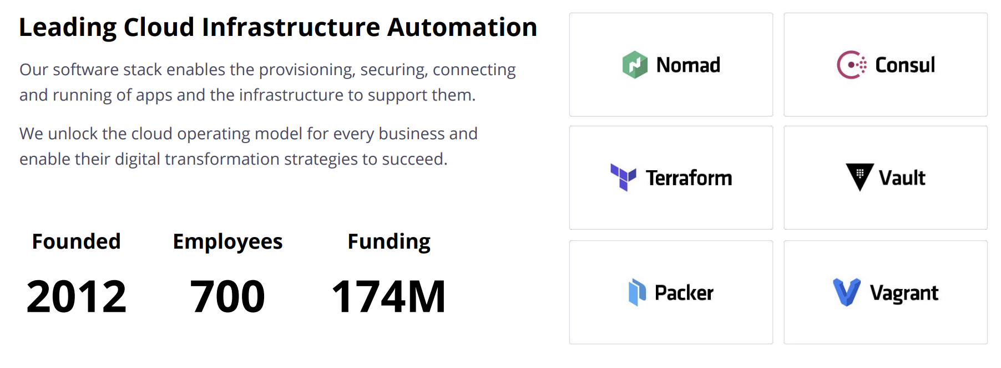
Company overview
Founded 2012 by Mitchell Hashimoto and Armon Dadgar
Mission We enable organizations to Provision, Secure, Connect, and run any infrastructure for any application
Key Products

Slide 8
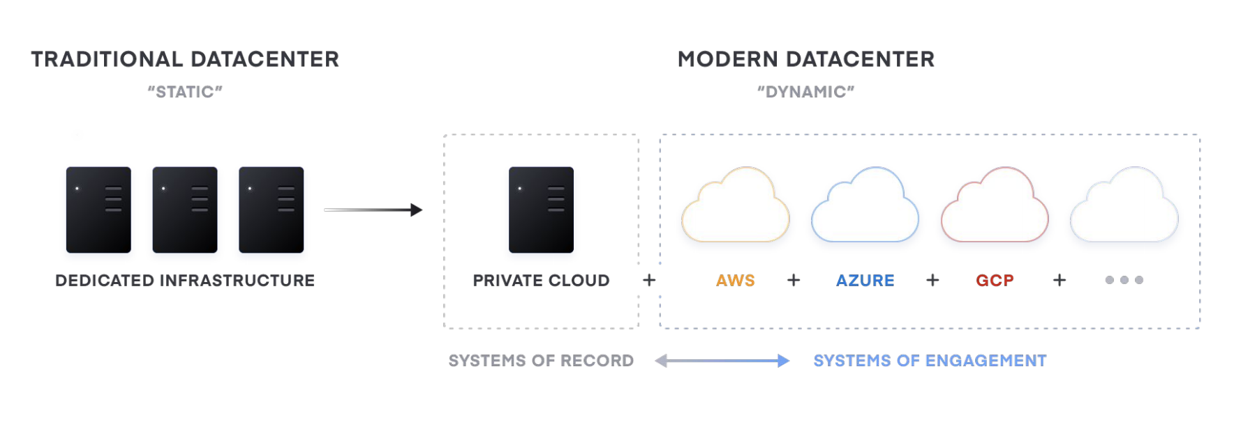
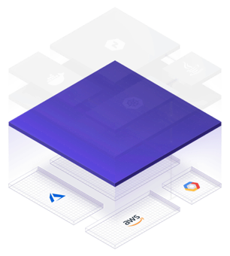
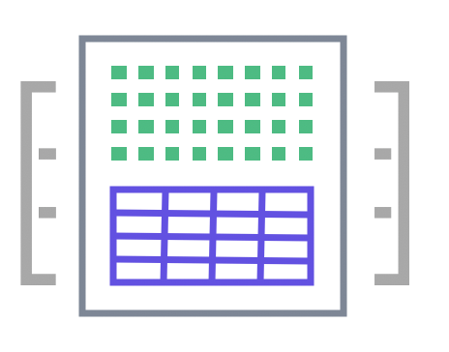
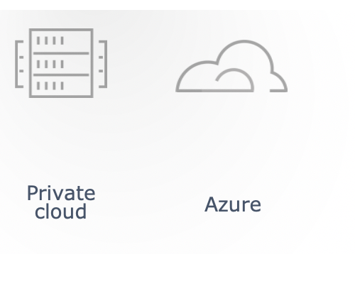

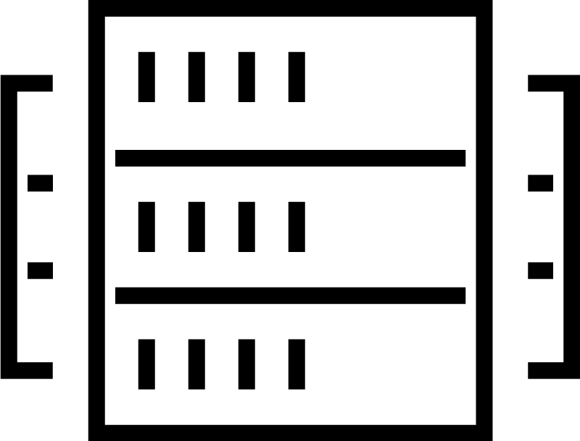
The shift to hybrid infrastructure
TRADITIONAL DATACENTER
EARLY CLOUD
MULTI-CLOUD

Slide 9
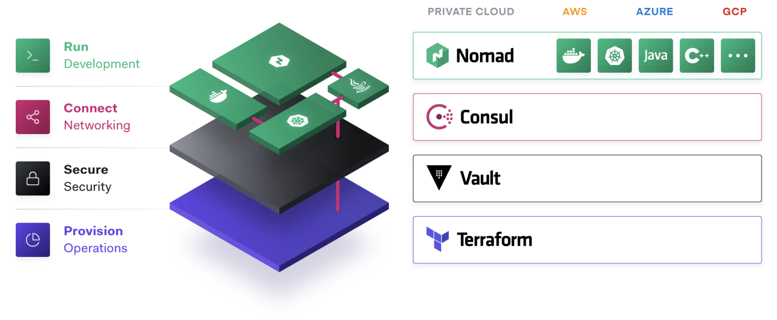
The Cloud Operating Model

Slide 10
Notes:
Learn more here: https://learn.hashicorp.com/terraform
Join the conversation here: http://discuss.hashicorp.com

Slide 11
What is Infrastructure as Code?

Slide 12
What is Infrastructure as Code?
Definition Wikipedia
Infrastructure as code is the process of managing and provisioning computer data centers through machine-readable definition files, rather than physical hardware configuration or interactive configuration tools.

Slide 13
What is Infrastructure as Code?
Description
Infrastructure as code (IaC) is the management of infrastructure (networks, virtual machines, load balancers etc.) using a high-level configuration syntax that stores files in a version control. This allows a blueprint of your datacenter to be versioned and treated as you would any other code. Additionally, infrastructure can be shared and re-used.

Slide 14
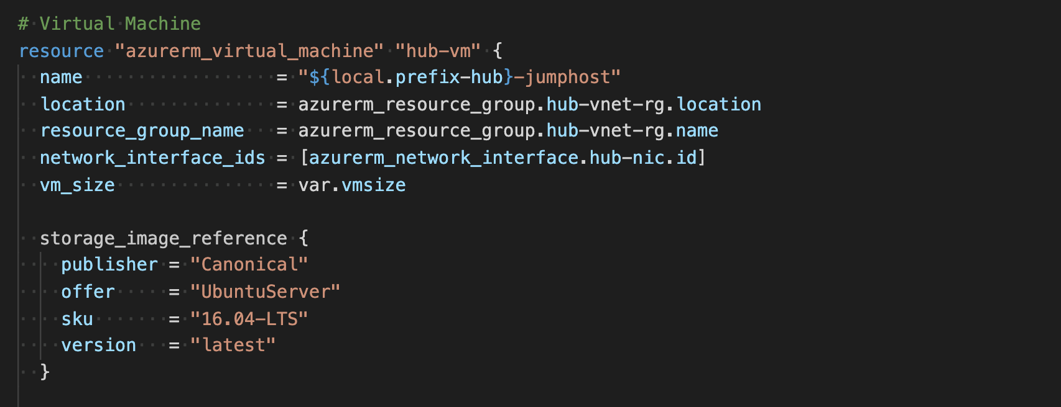
What is Infrastructure as Code?
Advantages
Stored in a source code repository (GitHub, Azure Repos…)
Lifecycle – Continuous Integration / Continuous Deployment (CI/CD)
Collaboration
Versioning
Reproducible
Scalable
Governance

Slide 15
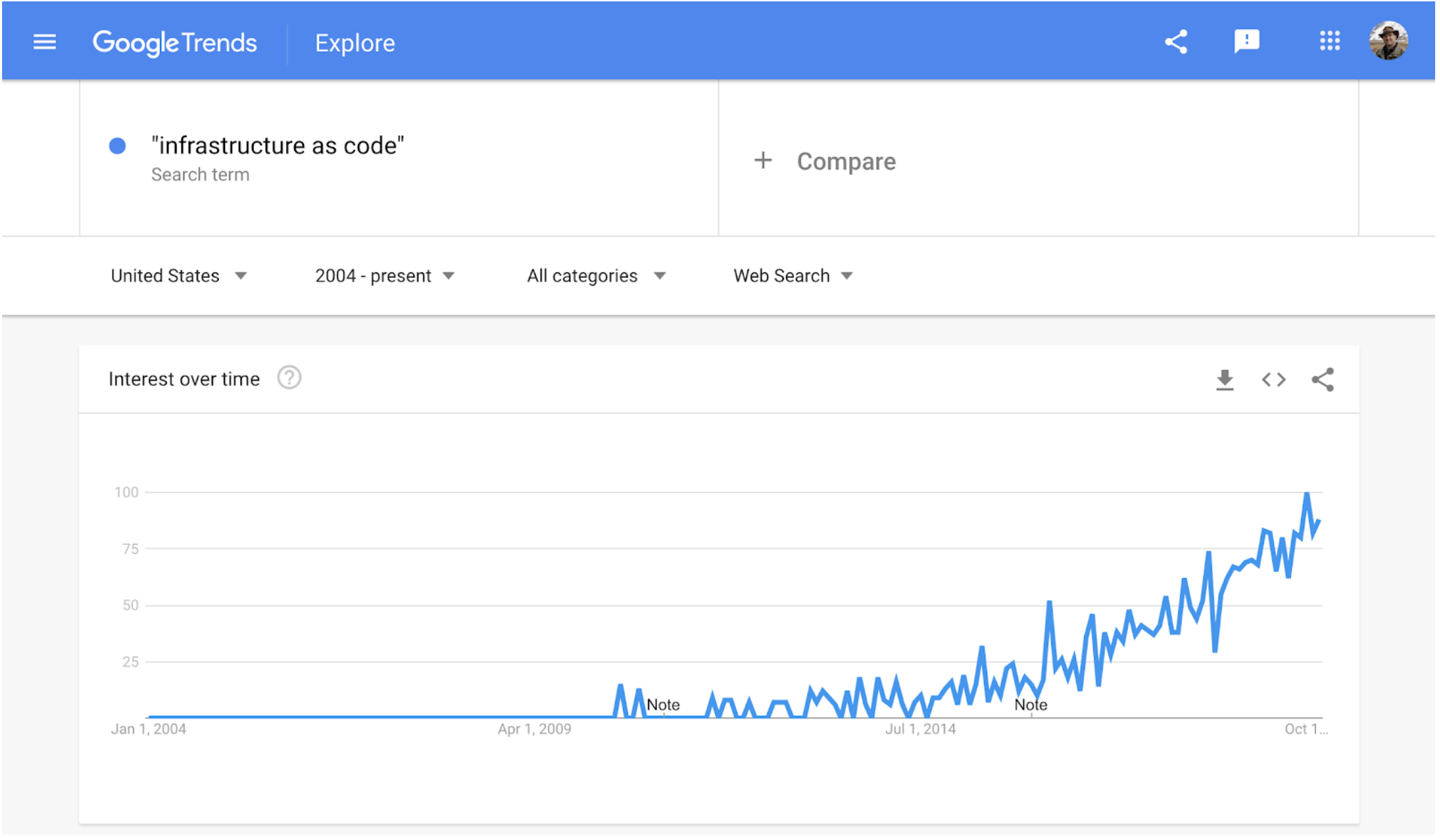
What is Infrastructure as Code?
Adaption

Slide 16
What is Infrastructure as Code?
Declarative VS Imperative
The difference between the declarative, the imperative approach is essentially 'what' versus 'how’.
The declarative approach focuses on what the eventual target configuration should be; the imperative focuses on how the infrastructure is to be changed to meet this.

Slide 17

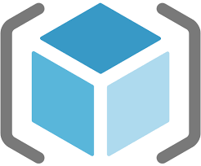
What is Infrastructure as Code?
Declarative
The declarative approach defines the desired state and the system executes what needs to happen to achieve that desired state.
IaC can use either scripts or declarative definitions, rather than manual processes, but the term is more often used to promote declarative approaches.
Imperative
Imperative defines specific commands that need to be executed in the appropriate order to end with the desired conclusion.
ARM
POWERSHELL
AZ CLI

Slide 18
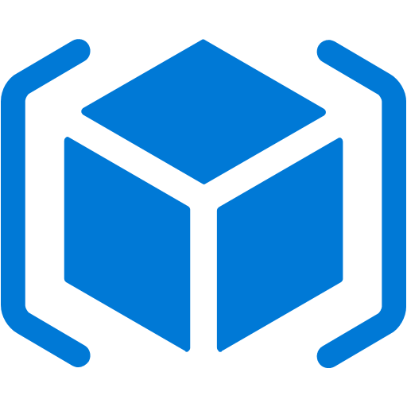
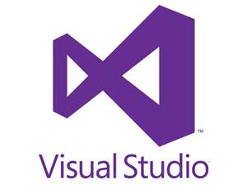
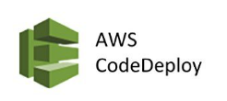


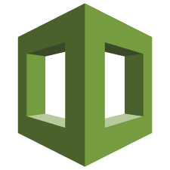
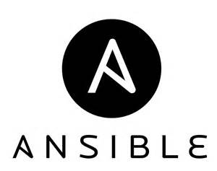

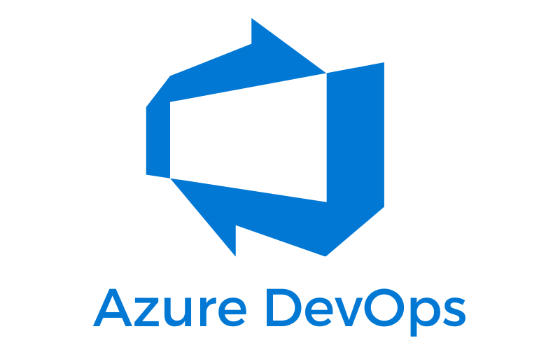




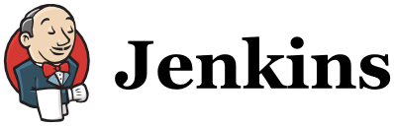
IaC in the DevOps Process Spectrum
Tools and Technologies
Core/Native
Operational Config
Cont. Integration / Deploy
Azure Resource
Manager
AWS
CloudFormation
Google Deployment
Manager
Desired State
Configuration
(DSC)
Platform
IT Ops
App/Dev/Ops

Slide 19
What is Terraform?

Slide 20
What is Terraform?
Definition Wikipedia
Terraform is an open-source(?) infrastructure as code software tool created by HashiCorp. It enables users to define and provision a datacenter infrastructure using a high-level configuration language known as Hashicorp Configuration Language (HCL), or optionally JSON.
Terraform supports a number of cloud infrastructure providers such as Amazon Web Services, IBM Cloud (formerly Bluemix), Google Cloud Platform, DigitalOcean, Linode, Microsoft Azure, Oracle Cloud Infrastructure, OVH, Scaleway, VMware vSphere or Open Telekom Cloud as well as OpenNebula and OpenStack.

Slide 21
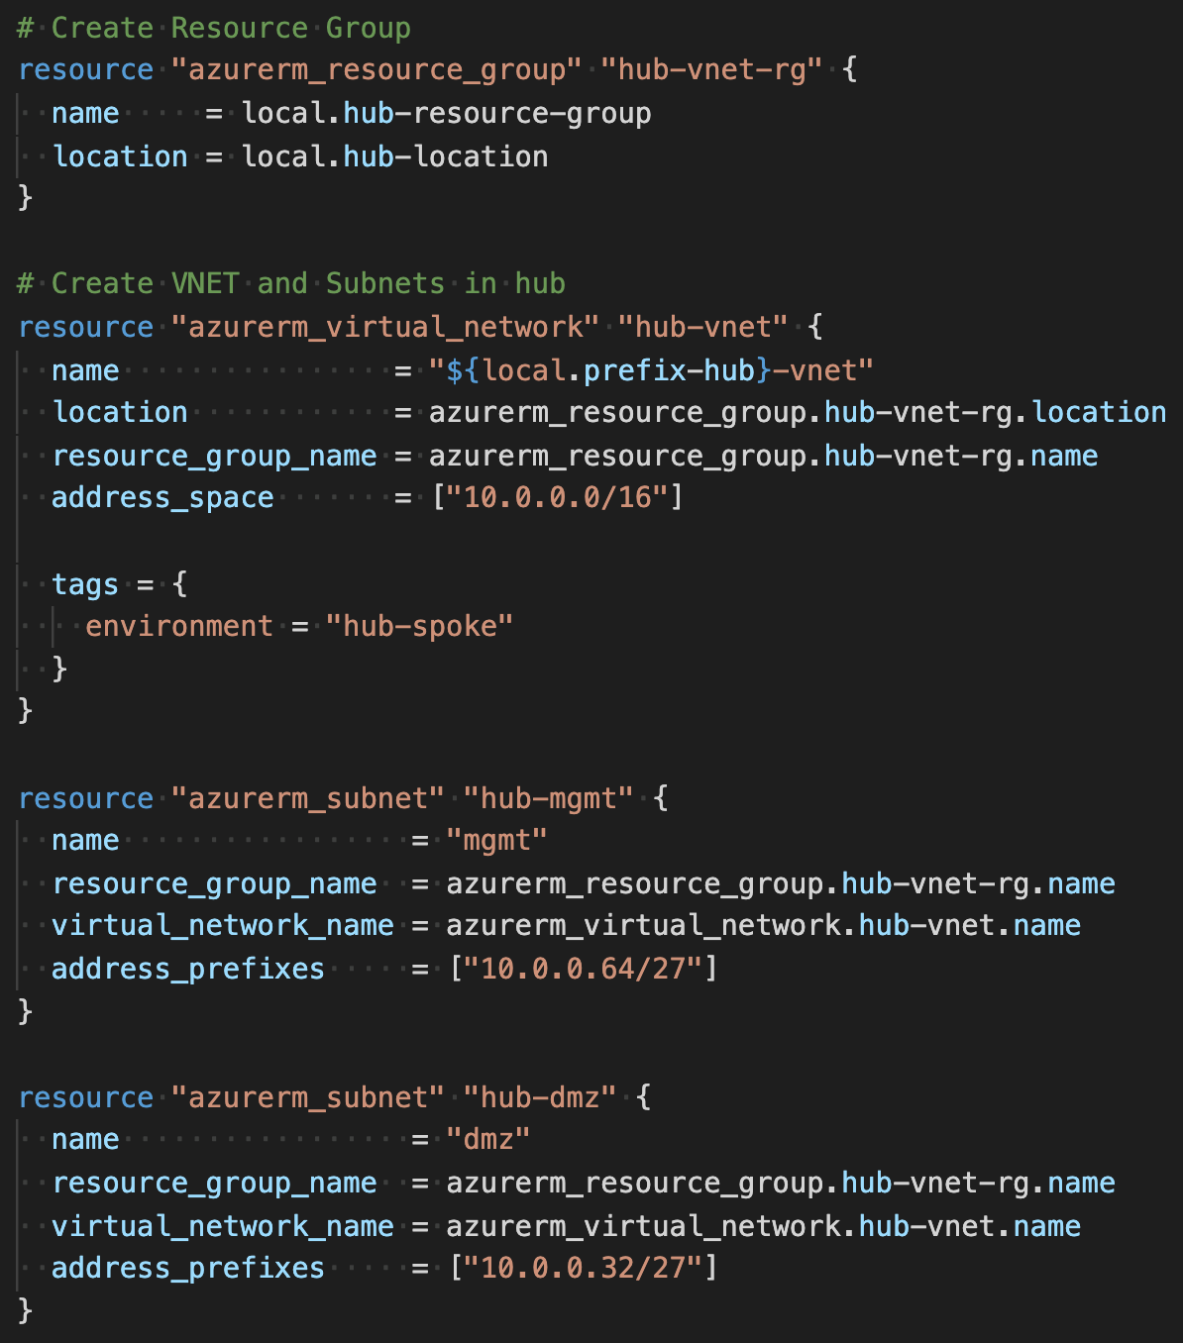
What is Terraform? Simplified
An open source tool/language (HCL) developed by HashiCorp
Common language for different providers: Azure, AWS, Google, VMware…
Allows to build, change and version infrastructure
Integrate different resources / providers into one script
Multi-cloud

Slide 22
Terraform L100

Slide 23


Terraform
Basics
Homepage: https://www.terraform.io/
Open Source Software
https://github.com/hashicorp/terraform
Written in GO
https://golang.org/

Slide 24
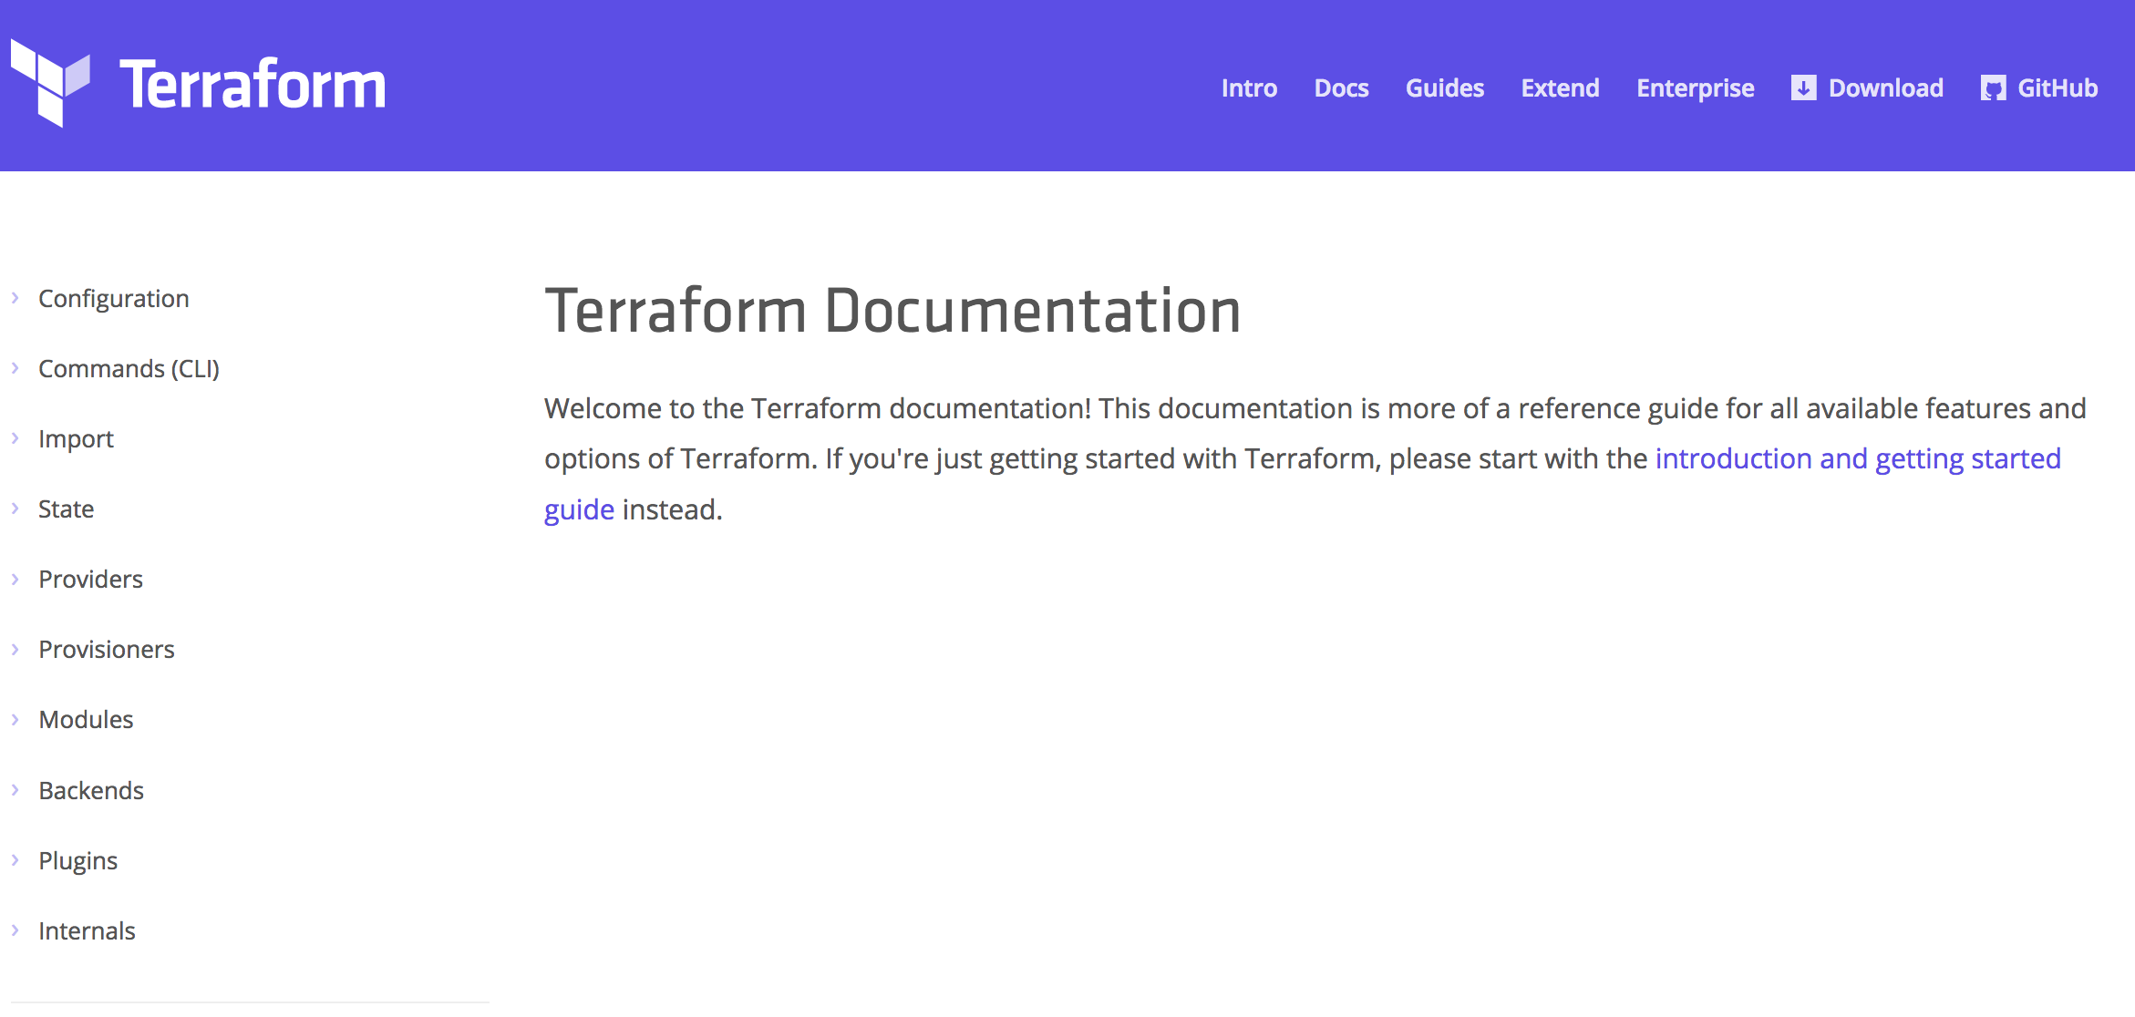
Terraform
Documentation
https://www.terraform.io/docs

Slide 25
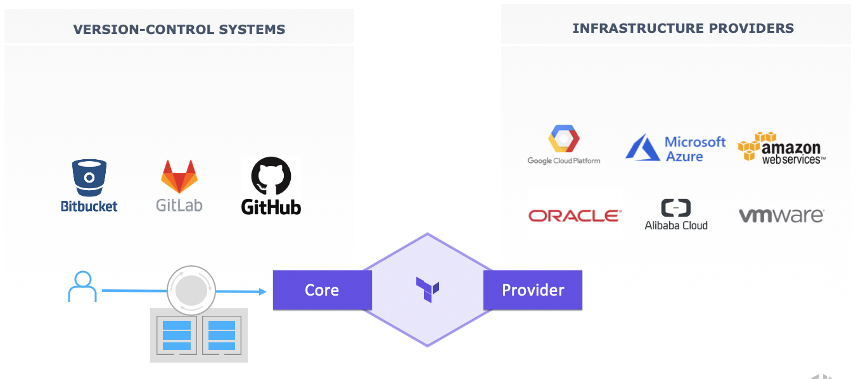
Terraform Ecosystem
Partnerships with 25+ technology providers, community support for many more

Slide 26
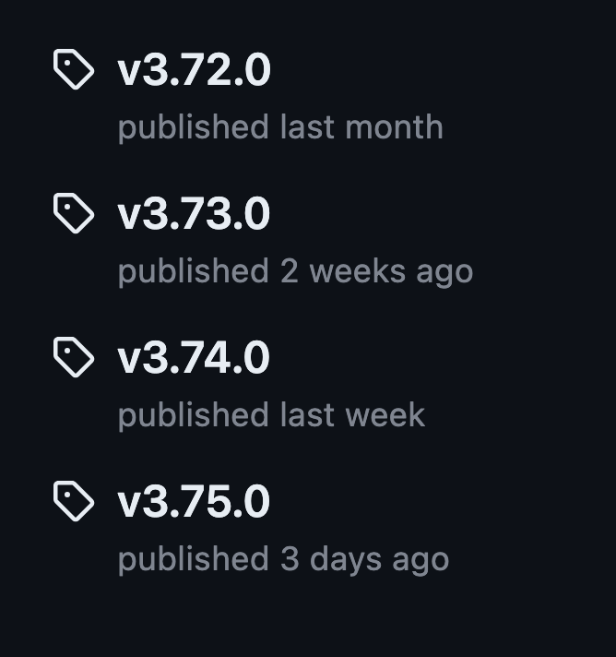
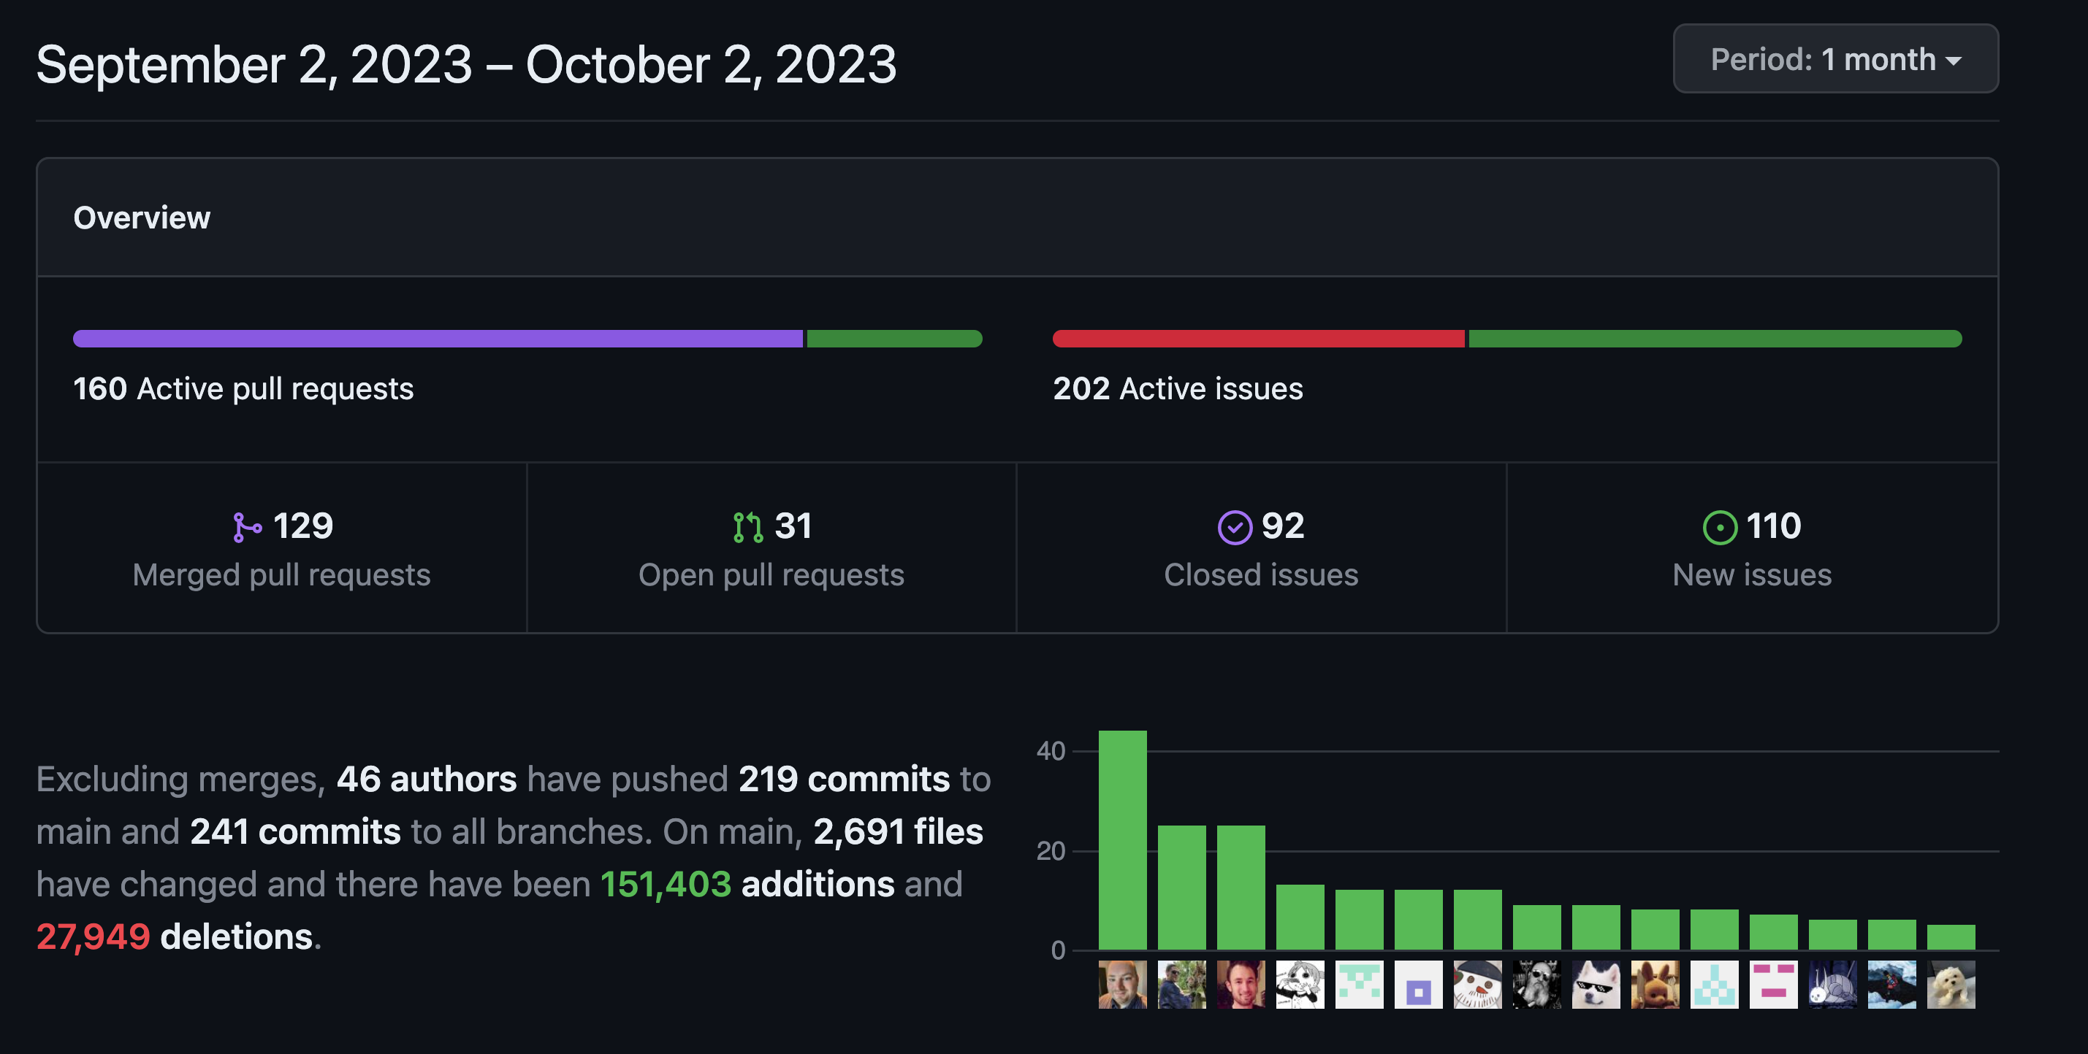
Terraform Providers
AzureRM

Slide 27
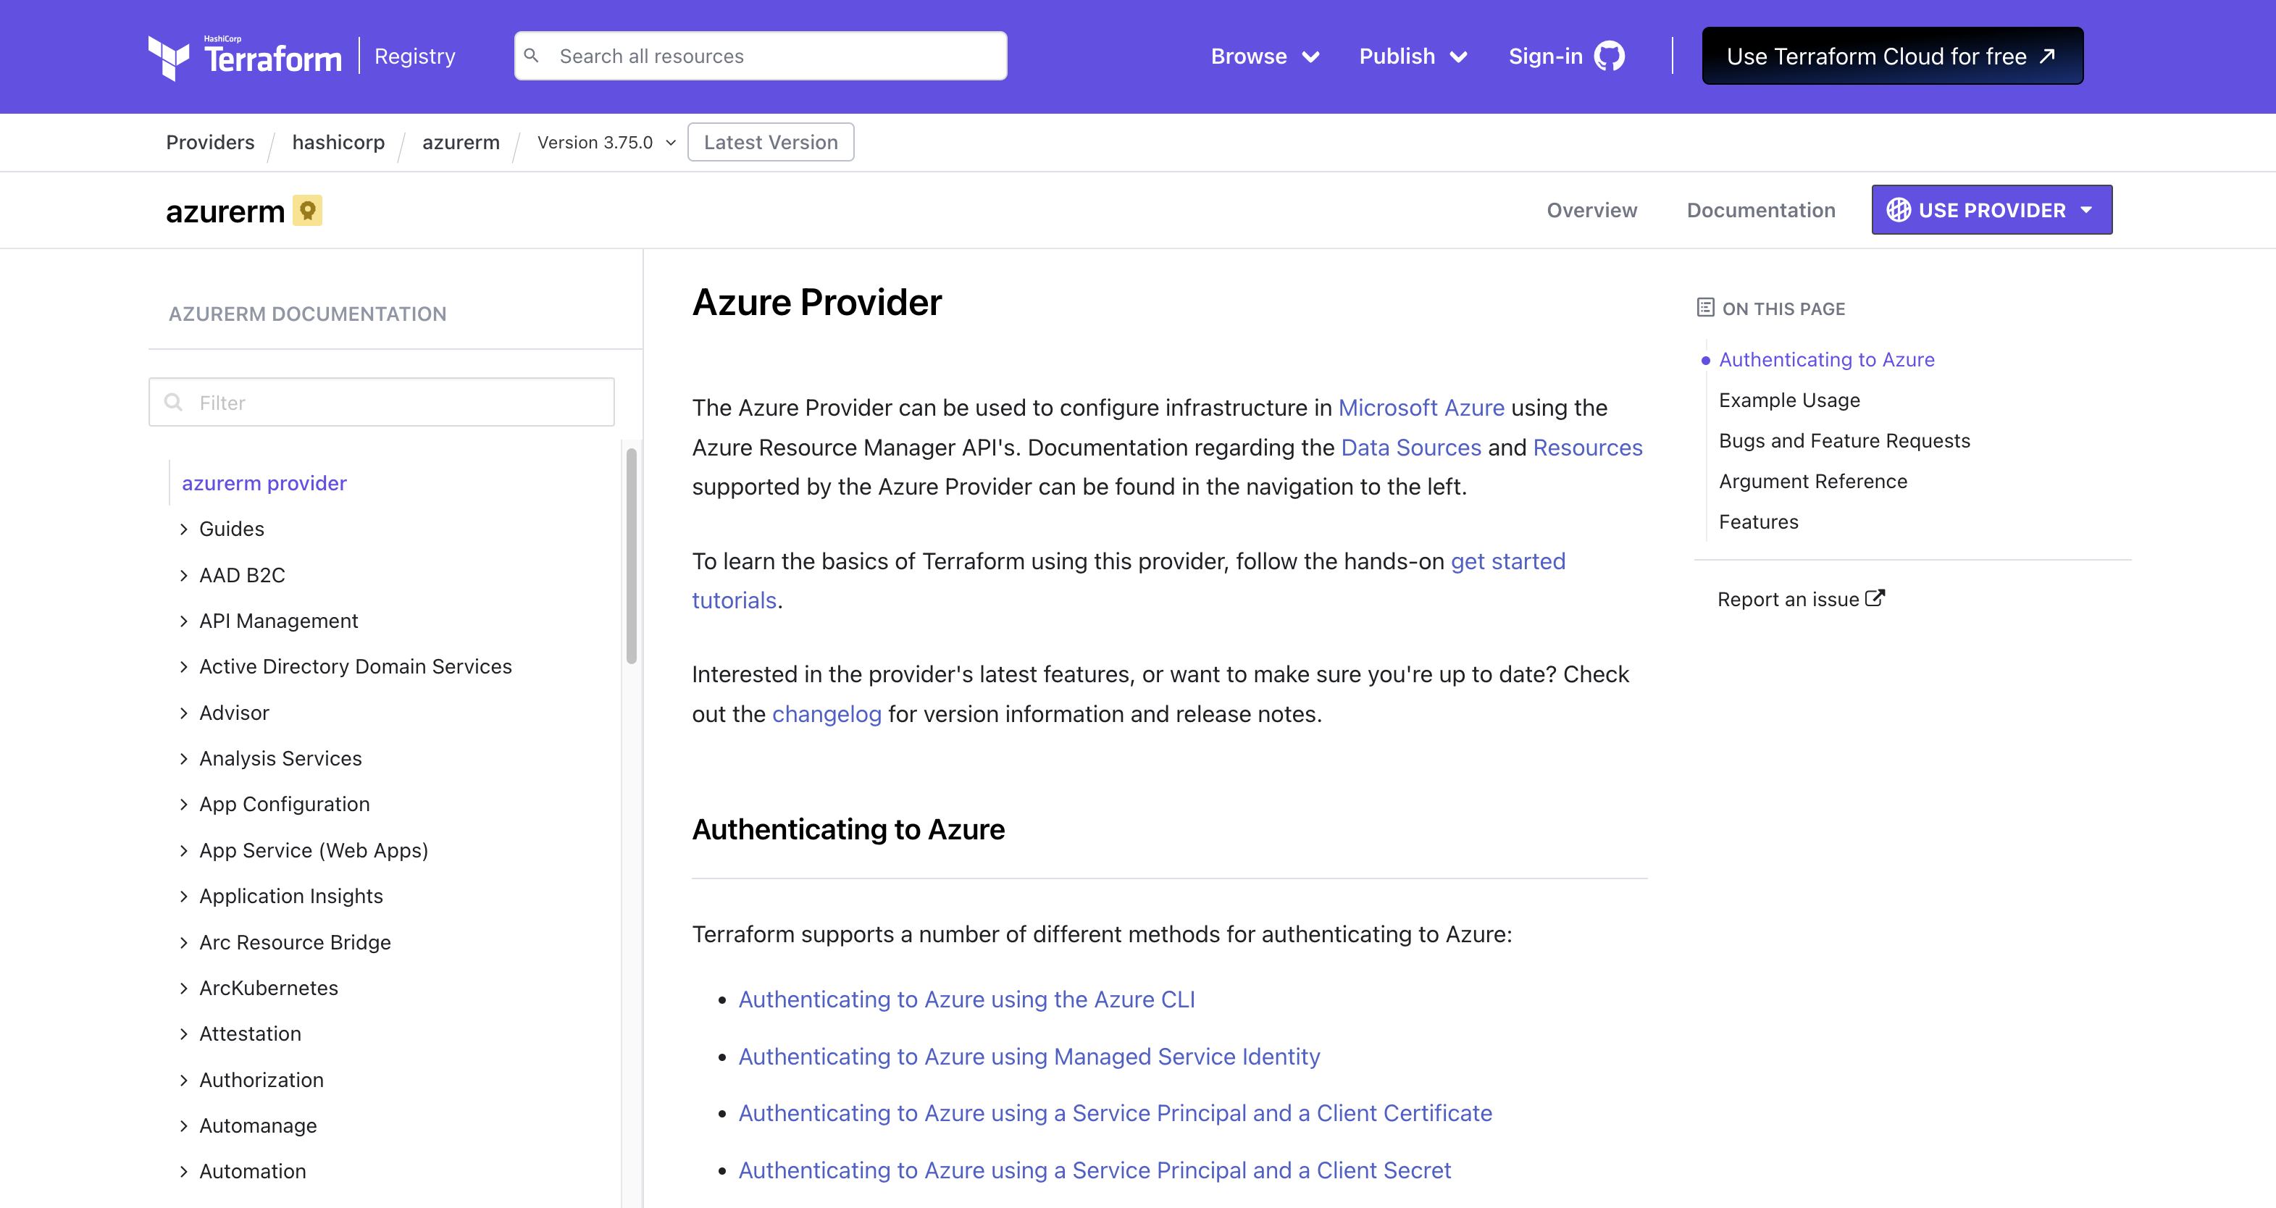
Terraform Providers
AzureRM Documentation
https://registry.terraform.io/providers/hashicorp/azurerm/latest/docs

Slide 28

Microsoft Terraform?

Slide 29
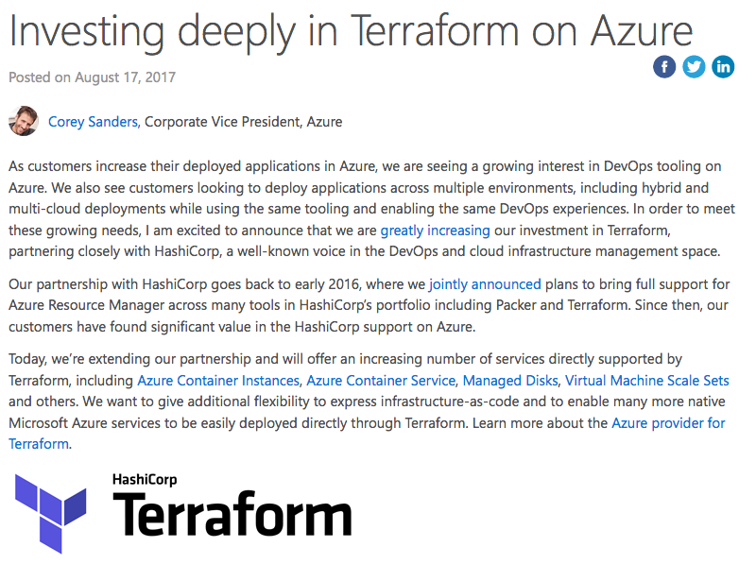
Microsoft <3 Terraform
Investment
Microsoft Investing in Terraform
Microsoft Product Team for Hashicorp
Terraform is a first class citizen in Azure
https://aka.ms/terraform
https://aka.ms/terraformdocs

Slide 30
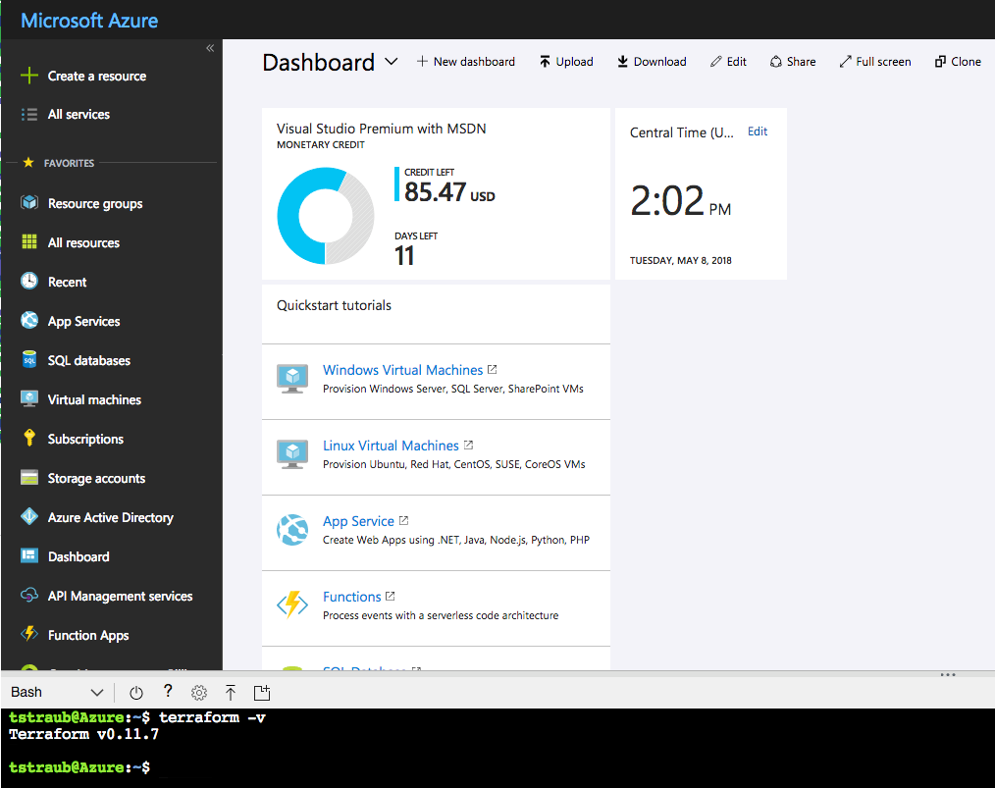
Microsoft <3 Terraform
Azure Cloud Shell Integration

Slide 31
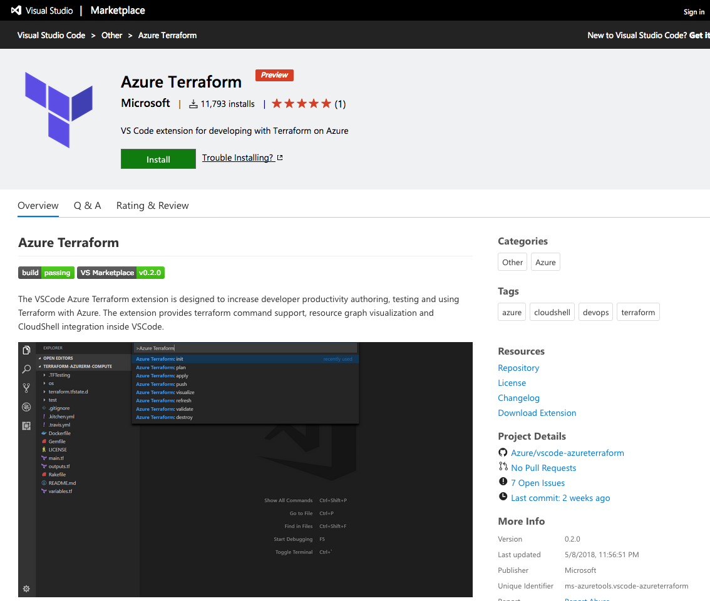
Microsoft <3 Terraform
VS Code Extension

Slide 32
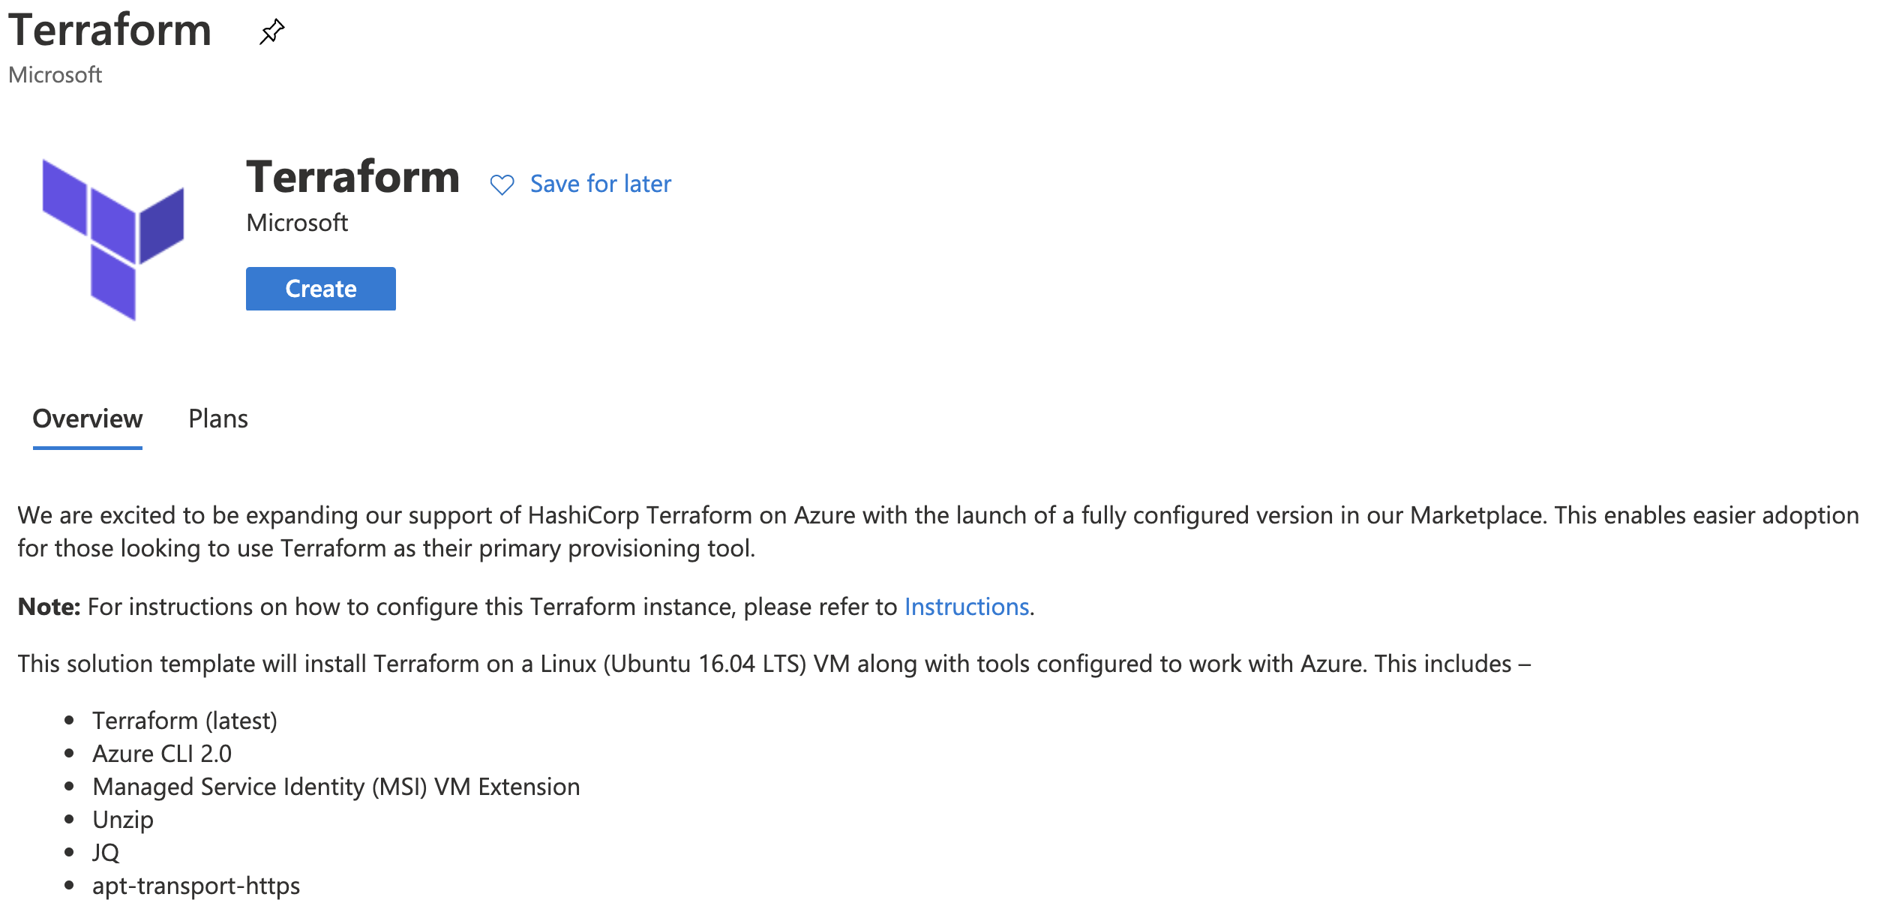
Microsoft <3 Terraform
Terraform Marketplace Image

Slide 33
Terraform Configuration

Slide 34
Terraform
terraform {
required_version = "= 1.5.7"
}
= | Exact version equality | = 1.5.7
!= | Exclude version | != 1.5.1
> >= < <= | Version comparison | >= 1.5.4
~> | Pessimistic constraint | ~> 1.5.7
https://www.terraform.io/docs/configuration/terraform.html
Notes:
Not required.
Version pinning, good idea in production.
= is optional, defaults
Pessimistic will go up until the next major version

Slide 35
AzureRm Provider
provider "azurerm" {
source = "hashicorp/azurerm"
version = ”= 3.24.0”
features = {}
}
https://www.terraform.io/docs/providers/azurerm/index.html
Notes:
Not required.
Version pinning, good idea in production.
= is optional, defaults
Pessimistic will go up until the next major version

Slide 36
Authentication to Azure
Azure CLI
az login
Uses your own credentials
Great for local development
Also how the Azure Cloud Shell works

Slide 37
Authentication to Azure
Service Principal
Preferred for shared environments
Works well in automation
Also how Terraform Enterprise/Cloud works

Slide 38
Authentication to Azure
Service Principal
provider "azurerm" {
version = ”3.24.0”
features = {}
subscription_id = "SUBSCRIPTION-ID"
client_id = "CLIENT-ID"
client_secret = "CLIENT-SECRET"
tenant_id = "TENANT-ID"
}
https://www.terraform.io/docs/providers/azurerm/guides/service_principal_client_secret.html

Slide 39
Azure Location
resource "azurerm_resource_group" "main" {
location = "eastus"
}
resource "azurerm_resource_group" "main" {
location = “East US”
}

Slide 40
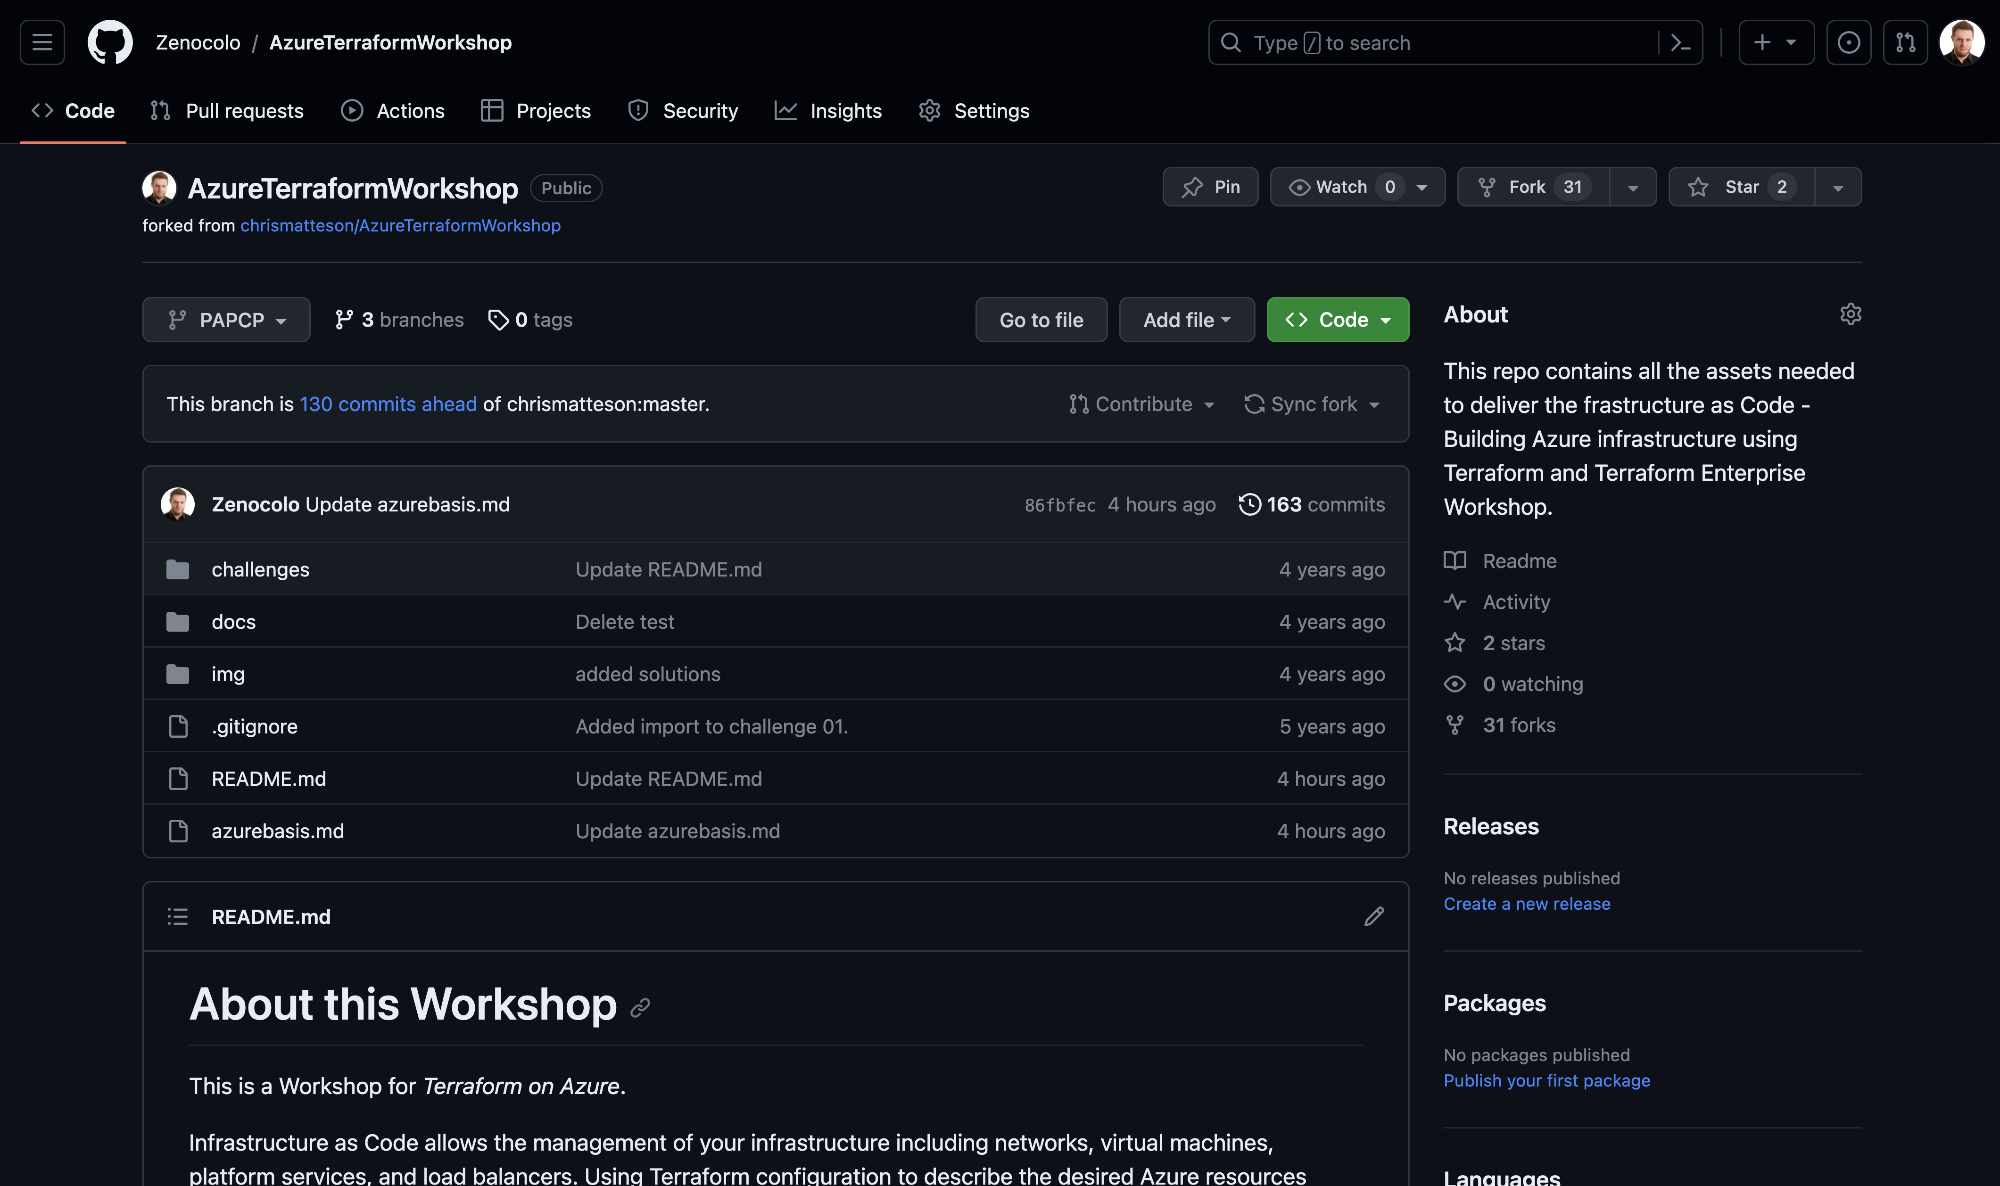
Workshop Repo
https://github.com/Zenocolo/AzureTerraformWorkshop/tree/PAPCP

Slide 41
Challenge
00 - Getting Started
01 - Connecting to Azure

Slide 42
Terraform State

Slide 43
Terraform State
File that stores state about your managed infrastructure
Keeps track of resource metadata
Used to map real world resources to your configuration.
Local terraform.tfstate file by default
https://www.terraform.io/docs/state/index.html

Slide 44
Terraform State
Config: Desired State
State: Current State
Diff: Delta of {Desired & Current}
Plan: Presents Diff
Apply: Resolves Diff
https://www.terraform.io/docs/state/index.html

Slide 45

Terraform State
State file can contain sensitive data
https://www.terraform.io/docs/state/sensitive-data.html

Slide 46
Terraform State – Operations
Configuration | State | Reality | Operation
azurerm_virtual_machine.app
https://www.terraform.io/docs/state/index.html

Slide 47
Terraform State – Operations
Configuration | State | Reality | Operation
azurerm_virtual_machine.app |  |  | CREATE
https://www.terraform.io/docs/state/index.html

Slide 48
Terraform State – Operations
Configuration | State | Reality | Operation
azurerm_virtual_machine.app |  |  | CREATE
azurerm_virtual_machine.app | azurerm_virtual_machine.app
https://www.terraform.io/docs/state/index.html

Slide 49
Terraform State – Operations
Configuration | State | Reality | Operation
azurerm_virtual_machine.app |  |  | CREATE
azurerm_virtual_machine.app | azurerm_virtual_machine.app |  | CREATE
https://www.terraform.io/docs/state/index.html

Slide 50
Terraform State – Operations
Configuration | State | Reality | Operation
azurerm_virtual_machine.app |  |  | CREATE
azurerm_virtual_machine.app | azurerm_virtual_machine.app |  | CREATE
azurerm_virtual_machine.app | azurerm_virtual_machine.app | azurerm_virtual_machine.app
https://www.terraform.io/docs/state/index.html

Slide 51
Terraform State – Operations
Configuration | State | Reality | Operation
azurerm_virtual_machine.app |  |  | CREATE
azurerm_virtual_machine.app | azurerm_virtual_machine.app |  | CREATE
azurerm_virtual_machine.app | azurerm_virtual_machine.app | azurerm_virtual_machine.app | NOOP
https://www.terraform.io/docs/state/index.html

Slide 52
Terraform State – Operations
Configuration | State | Reality | Operation
azurerm_virtual_machine.app |  |  | CREATE
azurerm_virtual_machine.app | azurerm_virtual_machine.app |  | CREATE
azurerm_virtual_machine.app | azurerm_virtual_machine.app | azurerm_virtual_machine.app | NOOP
 | azurerm_virtual_machine.app | azurerm_virtual_machine.app
https://www.terraform.io/docs/state/index.html

Slide 53
Terraform State – Operations
Configuration | State | Reality | Operation
azurerm_virtual_machine.app |  |  | CREATE
azurerm_virtual_machine.app | azurerm_virtual_machine.app |  | CREATE
azurerm_virtual_machine.app | azurerm_virtual_machine.app | azurerm_virtual_machine.app | NOOP
 | azurerm_virtual_machine.app | azurerm_virtual_machine.app | DELETE
https://www.terraform.io/docs/state/index.html

Slide 54
Terraform State – Operations
Configuration | State | Reality | Operation
azurerm_virtual_machine.app |  |  | CREATE
azurerm_virtual_machine.app | azurerm_virtual_machine.app |  | CREATE
azurerm_virtual_machine.app | azurerm_virtual_machine.app | azurerm_virtual_machine.app | NOOP
 | azurerm_virtual_machine.app | azurerm_virtual_machine.app | DELETE
 |  | azurerm_virtual_machine.app
https://www.terraform.io/docs/state/index.html

Slide 55
Terraform State – Operations
Configuration | State | Reality | Operation
azurerm_virtual_machine.app |  |  | CREATE
azurerm_virtual_machine.app | azurerm_virtual_machine.app |  | CREATE
azurerm_virtual_machine.app | azurerm_virtual_machine.app | azurerm_virtual_machine.app | NOOP
 | azurerm_virtual_machine.app | azurerm_virtual_machine.app | DELETE
 |  | azurerm_virtual_machine.app | NOOP
https://www.terraform.io/docs/state/index.html

Slide 56
Terraform State – Operations
Configuration | State | Reality | Operation
azurerm_virtual_machine.app |  |  | CREATE
azurerm_virtual_machine.app | azurerm_virtual_machine.app |  | CREATE
azurerm_virtual_machine.app | azurerm_virtual_machine.app | azurerm_virtual_machine.app | NOOP
 | azurerm_virtual_machine.app | azurerm_virtual_machine.app | DELETE
 |  | azurerm_virtual_machine.app | NOOP
azurerm_virtual_machine.app |  | azurerm_virtual_machine.app
https://www.terraform.io/docs/state/index.html

Slide 57
Terraform State – Operations
Configuration | State | Reality | Operation
azurerm_virtual_machine.app |  |  | CREATE
azurerm_virtual_machine.app | azurerm_virtual_machine.app |  | CREATE
azurerm_virtual_machine.app | azurerm_virtual_machine.app | azurerm_virtual_machine.app | NOOP
 | azurerm_virtual_machine.app | azurerm_virtual_machine.app | DELETE
 |  | azurerm_virtual_machine.app | NOOP
azurerm_virtual_machine.app |  | azurerm_virtual_machine.app | RECREATE
https://www.terraform.io/docs/state/index.html

Slide 58
Terraform State – Operations
Configuration | State | Reality | Operation
azurerm_virtual_machine.app |  |  | CREATE
azurerm_virtual_machine.app | azurerm_virtual_machine.app |  | CREATE
azurerm_virtual_machine.app | azurerm_virtual_machine.app | azurerm_virtual_machine.app | NOOP
 | azurerm_virtual_machine.app | azurerm_virtual_machine.app | DELETE
 |  | azurerm_virtual_machine.app | NOOP
azurerm_virtual_machine.app |  | azurerm_virtual_machine.app | RECREATE
 | azurerm_virtual_machine.app
https://www.terraform.io/docs/state/index.html

Slide 59
Terraform State – Operations
Configuration | State | Reality | Operation
azurerm_virtual_machine.app |  |  | CREATE
azurerm_virtual_machine.app | azurerm_virtual_machine.app |  | CREATE
azurerm_virtual_machine.app | azurerm_virtual_machine.app | azurerm_virtual_machine.app | NOOP
 | azurerm_virtual_machine.app | azurerm_virtual_machine.app | DELETE
 |  | azurerm_virtual_machine.app | NOOP
azurerm_virtual_machine.app |  | azurerm_virtual_machine.app | RECREATE
 | azurerm_virtual_machine.app |  | REMOVE FROM STATE
https://www.terraform.io/docs/state/index.html

Slide 60
Variables

Slide 61
Variables
variable "location" {
default = ”eastus"
description = ”Location to deploy Azure Infrastructure"
}
resource "azurerm_resource_group" "module" {
name = ”my-rg"
location = "${var.location}"
}
https://www.terraform.io/docs/configuration/variables.html
Notes:
Can be default or else required.
Default are literal and can not be interpolated.
Type is assumed.
Interpolation, more to come, VERY powerful
Description is purely for documentation (TF Registry)

Slide 62
Variables - Types
Strings
Strings are usually represented by a double-quoted sequence of Unicode characters, "like this". There is also a "heredoc" syntax for more complex strings.
String literals are the most complex kind of literal expression in Terraform, and have their own page of documentation. See Strings for information about escape sequences, the heredoc syntax, interpolation, and template directives.
Numbers
Numbers are represented by unquoted sequences of digits with or without a decimal point, like 15 or 6.283185.
Bools
Bools are represented by the unquoted symbols true and false.
Null
The null value is represented by the unquoted symbol null.
https://www.terraform.io/docs/configuration/variables.html

Slide 63
Variables - Types
Lists/Tuples
Lists/tuples are represented by a pair of square brackets containing a comma-separated sequence of values, like ["a", 15, true].
List literals can be split into multiple lines for readability, but always require a comma between values. A comma after the final value is allowed, but not required. Values in a list can be arbitrary expressions.
Maps/Objects
Maps/objects are represented by a pair of curly braces containing a series of <KEY> = <VALUE> pairs:
{
name = "John"
age = 52
}
Key/value pairs can be separated by either a comma or a line break.
The values in a map can be arbitrary expressions.
The keys in a map must be strings; they can be left unquoted if they are a valid identifier, but must be quoted otherwise. You can use a non-literal string expression as a key by wrapping it in parentheses, like (var.business_unit_tag_name) = "SRE".
https://www.terraform.io/docs/configuration/variables.html

Slide 64
Variables - Scoping
Variables are valid within the current module level.
test
├── app1.tf
├── app2.tf
└── variables.tf
https://www.terraform.io/docs/configuration/variables.html
Notes:
All files can declare and use variables.
Share the same scope.
Can not duplicate.
Revisit when we reach modules.

Slide 65
Variables – How to Use
Variable Files
terraform.tfvars
*.auto.tfvars
terraform plan -var-file=vars.tfvars
foo = "bar"
valid = true
somelist = [
"one",
"two",
]
https://www.terraform.io/docs/configuration/variables.html

Slide 66
Variables – How to Use
Command Line Parameters
terraform plan –var ‘foo=bar’ terraform plan –var ‘foo=bar’ –var ‘bar=foo’
https://www.terraform.io/docs/configuration/variables.html
Notes:
Pass as many as you like
Duplicates will be overridden.

Slide 67
Variables – How to Use
Environment Variables (TF_VAR_*)
export TF_VAR_foo=bar
export TF_VAR_bar=foo
https://www.terraform.io/docs/configuration/variables.html
Notes:
Great for automation.

Slide 68
Challenge
06 – Define Input Variables

Slide 69
Outputs

Slide 70
Outputs
Outputs define useful values that will be highlighted to the user when Terraform applies:
IP addresses
Usernames
Computed Values
Easily extract and query information from all resources
https://www.terraform.io/docs/configuration/outputs.html
Notes:
Each resource has a lot of metadata, showing it all would be too difficult to sort through.
Computed Values (dynamic IPs)
Customized outputs

Slide 71
Outputs
output "vm_private_ips" { value = "${azurerm_network_interface.app.private_ip_address}” description = "Dynamic Private IP Addresses” }

Slide 72
Outputs
sensitive — Suppressing Values in CLI Output
An output can be marked as containing sensitive material using the optional sensitive argument:
output "db_password" {
value = aws_db_instance.db.password
description = "The password for logging in to the database."
sensitive = true
}
Terraform will hide values marked as sensitive in the messages from terraform plan and terraform apply. In the following scenario, our root module has an output declared as sensitive and a module call with a sensitive output, which we then use in a resource attribute.
https://www.terraform.io/docs/configuration/outputs.html
Notes:
Each resource has a lot of metadata, showing it all would be too difficult to sort through.
Computed Values (dynamic IPs)
Customized outputs

Slide 73
Interpolations

Slide 74
Interpolations
Embedded within strings in Terraform you can interpolate other values.
"${var.name}-rg"
The interpolation syntax is powerful and allows you to reference variables, attributes of resources, call functions, etc.
https://developer.hashicorp.com/terraform/language/v1.1.x/configuration-0-11/interpolation

Slide 75
Interpolations – Count
variable "count" {
default = 2
}
resource "azurerm_network_interface" "web" {
name = "nic-${count.index}"
count = "${var.count}"
}
resource "azurerm_virtual_machine" "web" {
count = "${var.count}"
network_interface_ids = ["${element(azurerm_network_interface.web.*.id, count.index)}"]
}
https://developer.hashicorp.com/terraform/language/v1.1.x/configuration-0-11/interpolation#count-information
Notes:
One of the most important!
count.index scoped to resource

Slide 76
Interpolations - Conditionals
resource "azurerm_virtual_machine" "web" {
subnet = "${var.size == "small" ? var.small_vm : var.large_vm}"
}
https://developer.hashicorp.com/terraform/language/v1.1.x/configuration-0-11/interpolation#conditionals

Slide 77
Interpolations – Built-In Functions
concat(list1, list2, ...) - Combines two or more lists into a single list.
concat(var.base_tags, var.additional_tags)
element(list, index) - Returns a single element from a list at the given index.
element(azurerm_subnet.foo.*.id, count.index)
element(var.list_of_strings, 2)
https://www.terraform.io/docs/configuration/interpolation.html
Notes:
Element() If the index is greater than the number of elements, this function will wrap using a standard mod algorithm.

Slide 78
Interpolations – Built-In Functions
format(format, args, ...) - Formats a string according to the given format. The syntax for the format is standard sprintf syntax.
Example to zero-prefix a count, used commonly for naming servers
format("web-%03d", 2).
https://www.terraform.io/docs/configuration/interpolation.html
Notes:
Format, for index =2 -> “web-002”

Slide 79
Interpolations – Math
resource "azurerm_virtual_machine" "module" {
name = "myvm-${count.index + 1}"
}
resource "azurerm_virtual_machine" "module" {
name = "${format("myvm-%03d", count.index + 1)}"
}
https://developer.hashicorp.com/terraform/language/v1.1.x/configuration-0-11/interpolation#math

Slide 80
Interpolations – locals
variable "name" {
default = "dev"
}
locals {
module_name = "${var.name}-sql"
}
https://developer.hashicorp.com/terraform/language/v1.1.x/configuration-0-11/locals
Notes:
Private variable

Slide 81
Challenge
02 - Creating Azure Kubernetes Cluster
03 - Scaling Infrastructure with Count

Slide 82
Modules

Slide 83
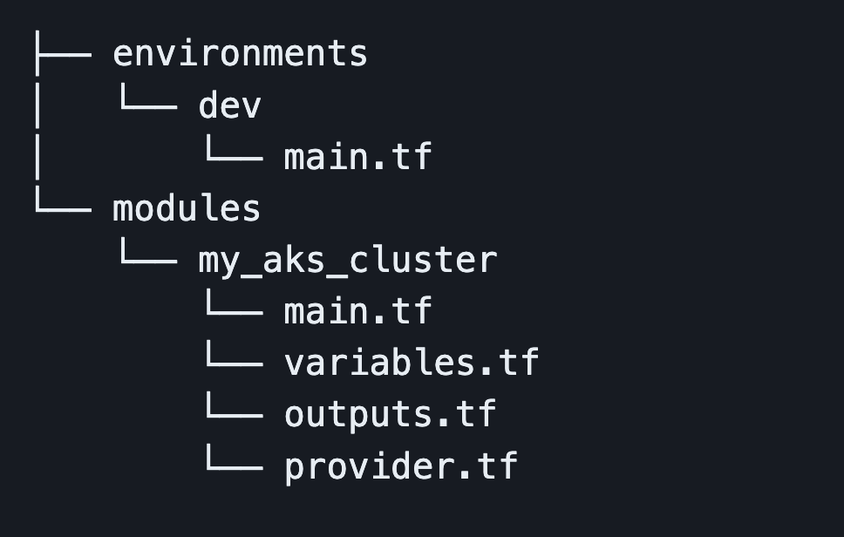
Modules
Root module: The current working directory when you run terraform init/plan/apply, holding the Terraform configuration files. It is itself a valid module.
Variable scoping: Variables are scoped only to the module in which they are declared. There is no inheritance!
Notes:
You have been using modules all along.
Variable scoping.

Slide 84
Module Usage
module ”mymodule" {
source = ”path/to/module"
name = "mysuperapp"
...
}
https://www.terraform.io/docs/modules

Slide 85
Module Sources
Local
Github
Generic git repo
Bitbucket
HTTP URLs
Registry (support versioning)
https://www.terraform.io/docs/modules

Slide 86
Module Usage
module "windowsservers" {
source = "Azure/compute/azurerm"
version = "1.1.5"
location = ”eastus"
vm_hostname = "mywinvm"
vm_os_simple = "WindowsServer"
}
https://www.terraform.io/docs/modules

Slide 87
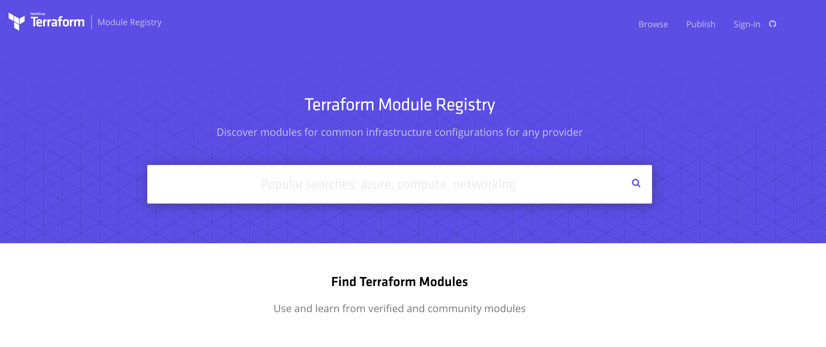
Public Module Registry

Slide 88
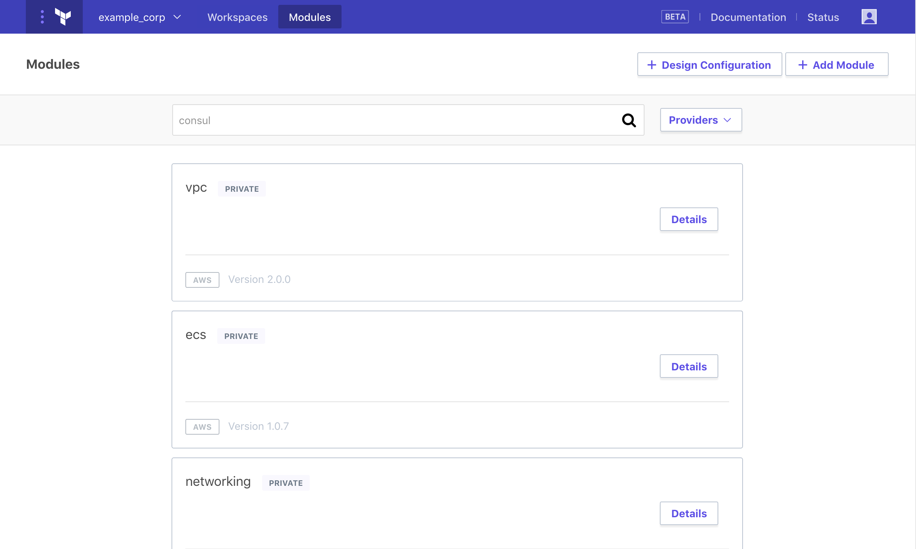
Private Module Registry
https://www.terraform.io/docs/modules
Notes:
Terraform Enterprise

Slide 89
Challenge
04 – Use Terraform Modules
05 – Use Public Module Registry

Slide 90
Dependencies

Slide 91
Dependencies
When Terraform changes infrastructure, many of the changes have to be made in a specific order. This order is determined by resource dependencies. There are two types of dependencies:
Implicit dependencies, which Terraform and the Azure provider determine automatically for you based on the configuration. For example, you can't create a new virtual machine without first having a network interface (NIC). Azurerm "knows" to create the NIC before attempting to create the VM.
Explicit dependencies, which you define using the depends_on meta-argument. Explicit dependencies are used when Terraform can't "see" an implicit dependency, and when you want to override the default execution plan.
https://developer.hashicorp.com/terraform/language/meta-arguments/depends_on
Notes:
You have been using modules all along.
Variable scoping.

Slide 92
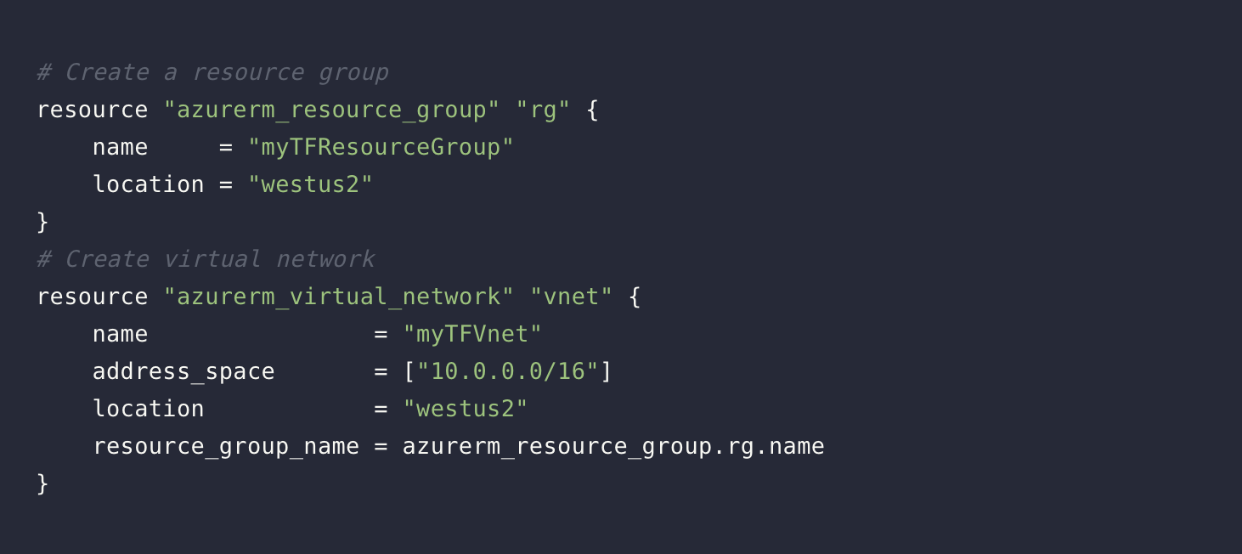
Implicit Dependencies
Terraform can infer when one resource depends on another by analyzing the resource attributes used in interpolation expressions. The act of referencing an attribute from another resource in the argument value of a resource results in an implicit dependency. From this Terraform builds a dependency tree to determine the correct order in which to create the each resource. Use implicit dependencies wherever possible.
https://developer.hashicorp.com/terraform/language/meta-arguments/depends_on
Notes:
You have been using modules all along.
Variable scoping.

Slide 93
Explicit Dependencies
Sometimes there are dependencies between resources that are not visible to Terraform. In these scenarios, use the depends_on meta-argument to explicitly define these dependencies.
Explicit dependencies:
Control of the order in which resources are created
Can be used to create parallel flows in the configuration
May be needed when a configuration depends on processes outside the domain of Terraform and Azure provider
https://developer.hashicorp.com/terraform/language/meta-arguments/depends_on
Notes:
You have been using modules all along.
Variable scoping.

Slide 94
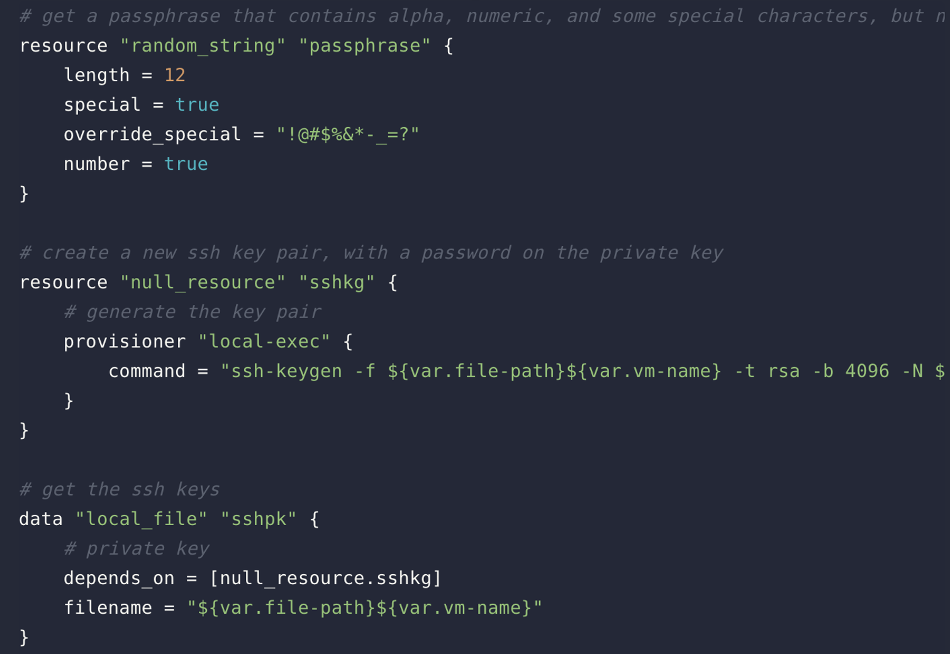
Explicit Dependencies
The following code snippet uses the Local, Null, and Random providers. In this example, Terraform has no way of knowing that the local_file data resources depend on the result of the local-exec provisioner. (We will discuss provisioners in a later lesson.)
https://developer.hashicorp.com/terraform/language/meta-arguments/depends_on
Notes:
You have been using modules all along.
Variable scoping.

Slide 95
Non-Dependent Resources
Configurations sometimes contain resources that do not depend on any other resource. For example, if you were to add another azurerm_virtual_machine block to create a second VM, there would be no dependency between the first and second VMs. Because there is no dependency between the VMs, they can be created in parallel.
Whenever possible, Terraform will perform operations concurrently. By default, Terraform will process up to 10 nodes concurrently while walking the graph.
https://developer.hashicorp.com/terraform/language/meta-arguments/depends_on
Notes:
You have been using modules all along.
Variable scoping.

Slide 96
Provisioners

Slide 97
Provisioner
Terraform provisioners help you do additional setup and configuration when a resource is created or destroyed. You can move files, run shell scripts, and install software.
Provisioners are not intended to maintain desired state and configuration for existing resources. For that purpose, you should use one of the many tools for configuration management, such as Chef, Ansible, or PowerShell Desired State Configuration. (Terraform includes a chef provisioner.)
https://developer.hashicorp.com/terraform/language/resources/provisioners/syntax
Notes:
You have been using modules all along.
Variable scoping.

Slide 98
Provisioner
Provisioners are defined on resources, most commonly a new instance of a virtual machine or container.
Terraform provides a special null_resource that allows you to configure provisioners that are not directly associated with an existing resource. Like all resources, null_resource supports meta-parameters such as depends_on, allowing you to control when a provisioner is run.
https://developer.hashicorp.com/terraform/language/resources/provisioners/syntax
Notes:
You have been using modules all along.
Variable scoping.

Slide 99
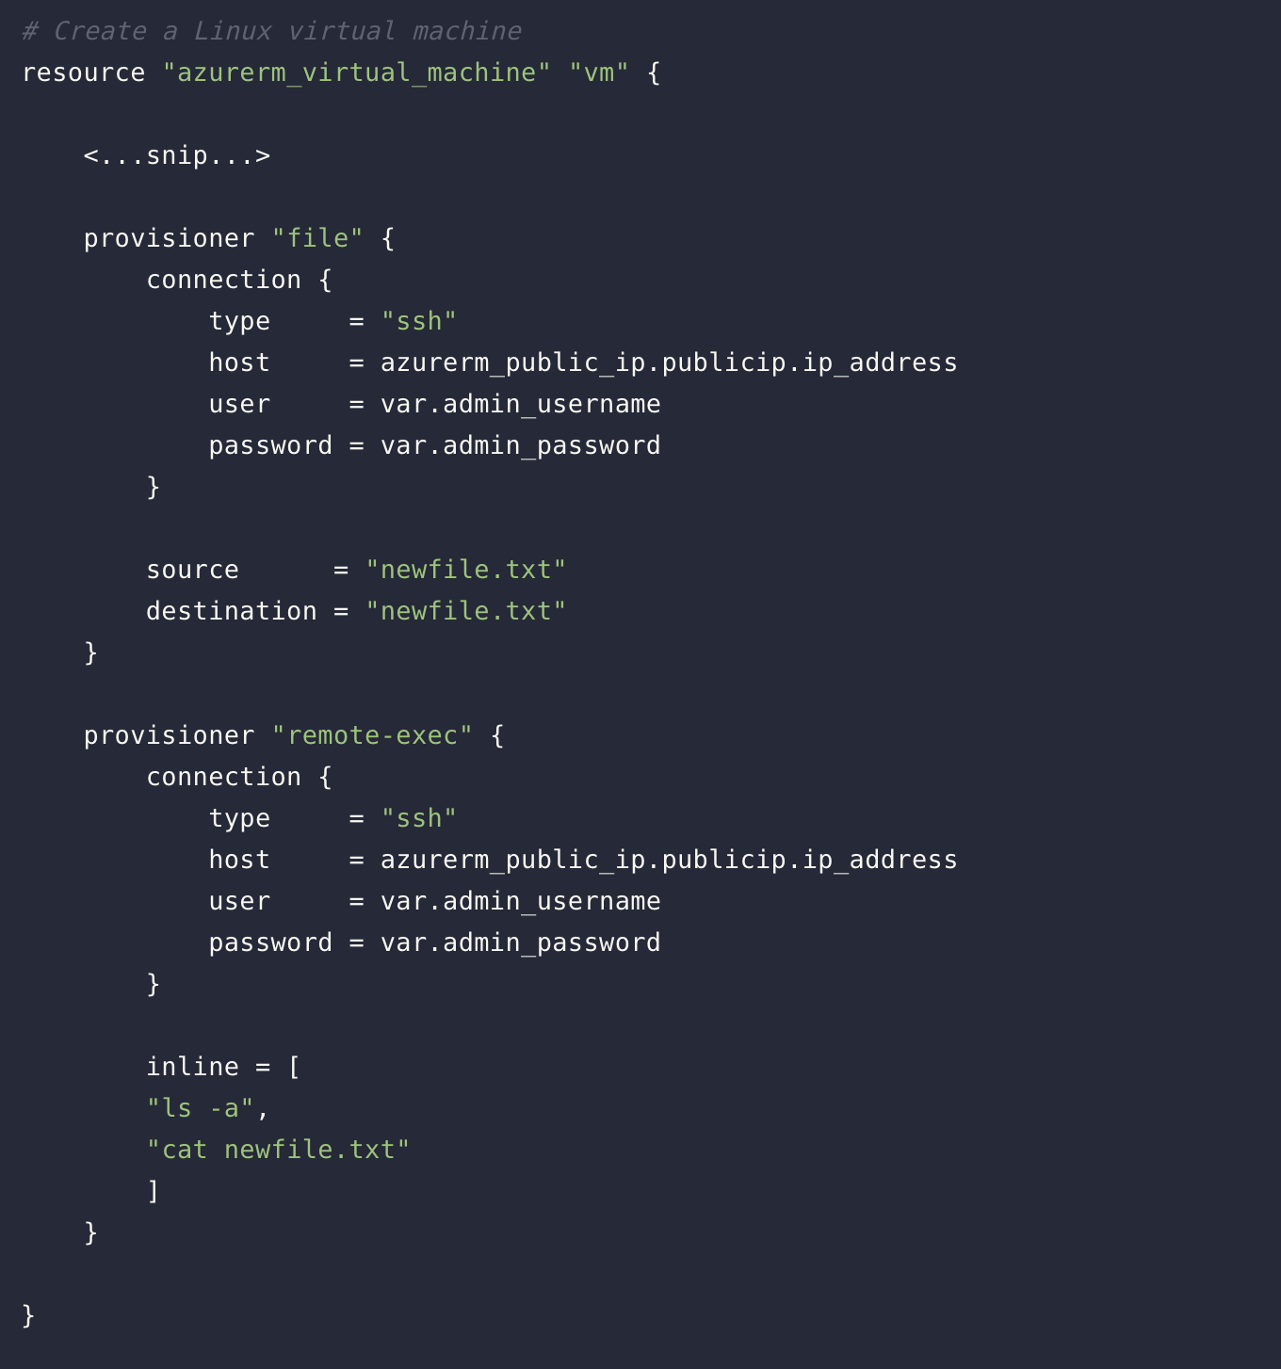
Provisioner
As this example shows, you can define more than one provisioner in a resource block. The file and remote-exec providers are used to perform two simple setup tasks:
File copies a text file from the machine that is running Terraform to the new VM instance.
Remote-exec runs two commands to list the home folder contents and display the contents of the text file.
https://developer.hashicorp.com/terraform/language/resources/provisioners/syntax
Notes:
You have been using modules all along.
Variable scoping.

Slide 100
Provisioner
Provisioners run when a resource is created, or a resource is destroyed. Provisioners do not run during update operations.
The example configuration for this section defines two provisioners that run only when a new virtual machine instance is created. If the virtual machine instance is later modified or destroyed, the provisioners will not run.
https://developer.hashicorp.com/terraform/language/resources/provisioners/syntax
Notes:
You have been using modules all along.
Variable scoping.

Slide 101
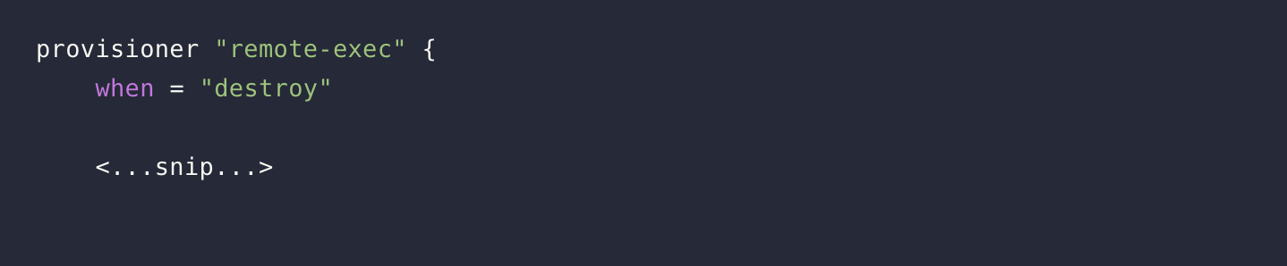
Provisioner
Provisioners can also be defined that run only during a destroy operation. These are known as destroy-time provisioners. Destroy provisioners are useful for performing system cleanup, extracting data, etc.
The following code snippet shows how a destroy provisioner is defined:
https://developer.hashicorp.com/terraform/language/resources/provisioners/syntax
Notes:
You have been using modules all along.
Variable scoping.

Slide 102
Backend

Slide 103
Backend
Determines how state is loaded and how an operations are executed.
Enables non-local file state storage, remote execution, etc.
By default, Terraform uses the "local" backend.
https://developer.hashicorp.com/terraform/language/settings/backends/configuration
Notes:
Use common state across others.

Slide 104
Backend-azurerm
azurerm:
Stores the state as a Blob with the given Key within the Blob Container within the Blob Storage Account.
This backend supports state locking and consistency checking with Azure Blob Storage native capabilities.
https://developer.hashicorp.com/terraform/language/settings/backends/configuration
Notes:
Use common state across others.

Slide 105
Backend-azurerm
terraform {
backend "azurerm" {
storage_account_name = "myorgeastus8x76ghf"
container_name = "terraformstate"
key = "dev.terraform.tfstate"
}
}
https://developer.hashicorp.com/terraform/language/settings/backends/configuration

Slide 106
Challenge
07 – Use Azure Remote Backend

Slide 107
Terraform Internals

Slide 108
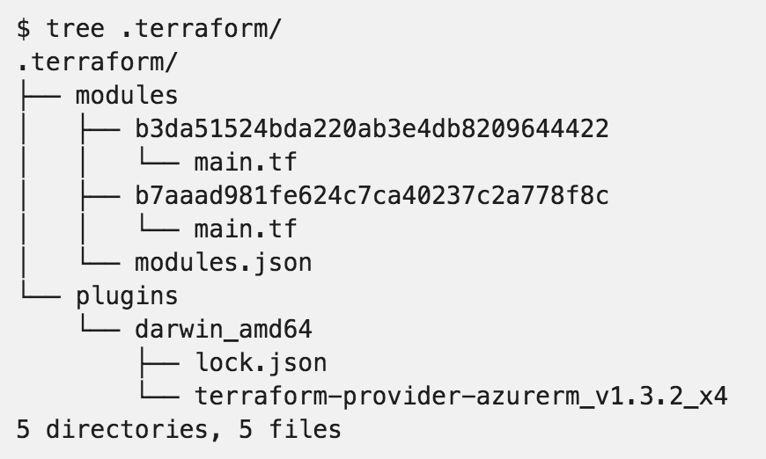
.terraform

Slide 109
Resource Addressing
Resource Address:
<MODULE PATH><RESOURCE SPEC>
azurerm_resource_group.module
module.A.azurerm_network_interface.web
https://www.terraform.io/docs/internals/resource-addressing.html

Slide 110
Resource Addressing
Module Path:
Addresses a module within a tree of modules.
module.A…
Can be multiple levels deep
module.A.module.B…
https://www.terraform.io/docs/internals/resource-addressing.html

Slide 111
Resource Addressing
Resource Spec:
resource_type.resource_name[N]
resource_type - Type of the resource being addressed.
resource_name - User-defined name of the resource.
[N] - where N is a 0-based index into a resource with multiple instances specified by the count meta-parameter.
https://www.terraform.io/docs/internals/resource-addressing.html

Slide 112
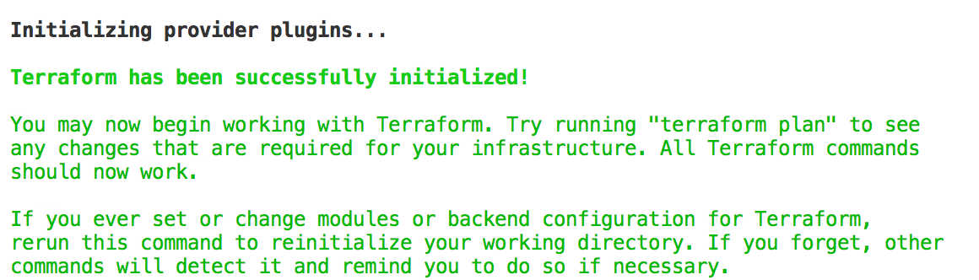
Commands - init
Usage: terraform init [options] [DIR]
https://www.terraform.io/docs/commands/init.html
Notes:
Can specify a DIR, but not recommended.

Slide 113
Commands - plan
Usage: terraform plan [options] [DIR-OR-PLAN]
Options:
-destroy If set, a plan will be generated to destroy all resources managed by the given configuration and state.
-parallelism=n Limit the number of concurrent operations. Defaults to 10.
-target=resource Resource to target.
https://www.terraform.io/docs/commands/plan.html

Slide 114
Commands - plan
Options:
-out=path Write a plan file to the given path.
-var 'foo=bar' Set a variable in the Terraform configuration. This flag can be set multiple times.
-var-file=foo Set variables in the Terraform configuration from a file.
https://www.terraform.io/docs/commands/plan.html

Slide 115
Commands - apply
Usage: terraform apply [options] [DIR-OR-PLAN]
https://www.terraform.io/docs/commands/apply.html

Slide 116
Commands - destroy
Usage: terraform destroy [options] [DIR]
https://www.terraform.io/docs/commands/destroy.html

Slide 117
Commands - fmt
Rewrites all Terraform configuration files in the current working directory.
Usage: terraform fmt [options] [DIR]
Options:
-check=false Check if the input is formatted. Exit status will be 0 if all input is properly formatted and non-zero otherwise.
https://www.terraform.io/docs/commands/fmt.html
Notes:
-check, great for CI server checks.

Slide 118
Commands - validate
Usage: terraform validate [options] [dir]
Validate the terraform files in a directory. Validation includes a basic check of syntax as well as checking that all variables declared in the configuration are specified.
https://www.terraform.io/docs/commands/validate.html

Slide 119
Commands - refresh
Usage: terraform refresh [options] [dir]
Update the state file of your infrastructure with metadata that matches the physical resources they are tracking.
This will not modify your infrastructure, but it can modify your state file to update metadata. This metadata might cause new changes to occur when you generate a plan or call apply next.
https://www.terraform.io/docs/commands/refresh.html

Slide 120
Commands - output
Usage: terraform output [options] [NAME]
Options:
-module=name If specified, returns the outputs for a specific module
-json If specified, machine readable output will be printed in JSON format
https://www.terraform.io/docs/commands/output.html

Slide 121
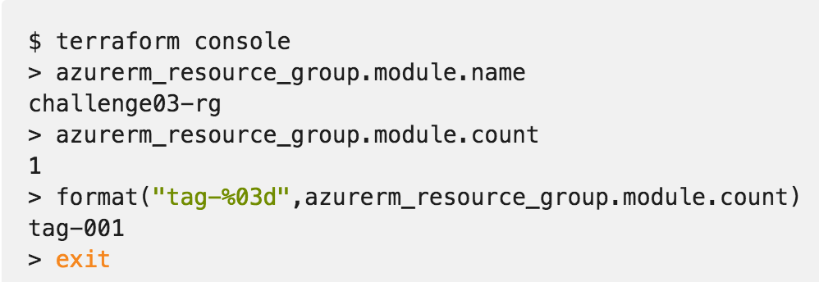
Commands - console
Creates an interactive console for interacting with Terraform.
Useful for experimenting with interpolations
and interacting with Terraform state.
https://www.terraform.io/docs/commands/console.html
Notes:
Doesn’t modify state
Can read remotes
Can work with out a state (just nothing to query)

Slide 122
Commands - graph
Usage: terraform graph [options] [DIR]
Outputs the visual execution graph of Terraform resources according to configuration files in DIR (or the current directory if omitted).
The graph is outputted in DOT format.
https://www.terraform.io/docs/commands/graph.html

Slide 123
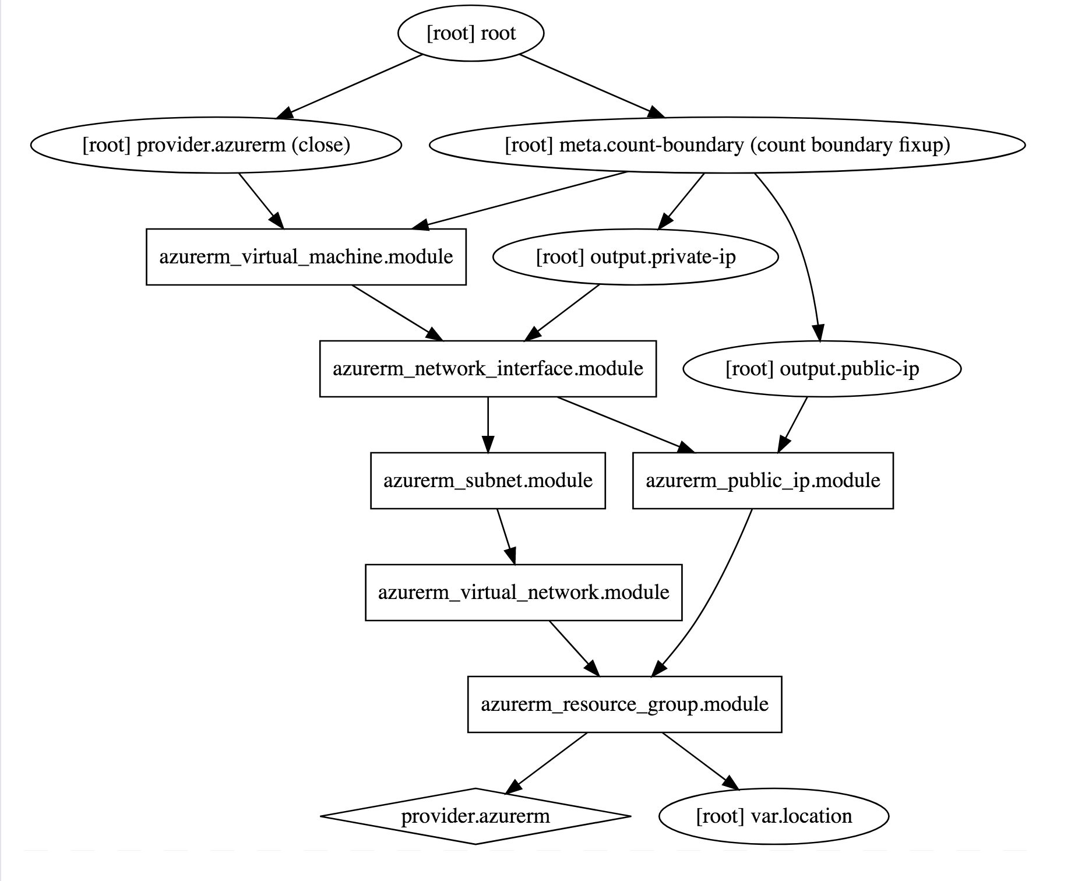
Commands - graph
terraform graph |
dot -Tsvg > graph.svg
https://www.terraform.io/docs/commands/graph.html

Slide 124
Advanced Commands
- state (list, mv, pull, push, rm, show)
- import
- taint/untaint

Slide 125
Azure Secrets with Terraform

Slide 126
Azure Secrets
In any real world Infrastructure as Code project, you will have secrets such as tokens, passwords, connection strings, certificates, encryption keys, etc. that are required in order to provision the desired resources. Although these are required by the code, you should NOT include the actual secret in the code.
There are a number of ways to reference secrets from code of varying ease of use and security. A good practice in Azure is to use Azure Key Vault, to store, manage and reference your secrets.
Notes:
Use common state across others.

Slide 127
Challenge
08 – Work with Azure Secrets

Slide 128
Azure DevOps with Terraform

Slide 129
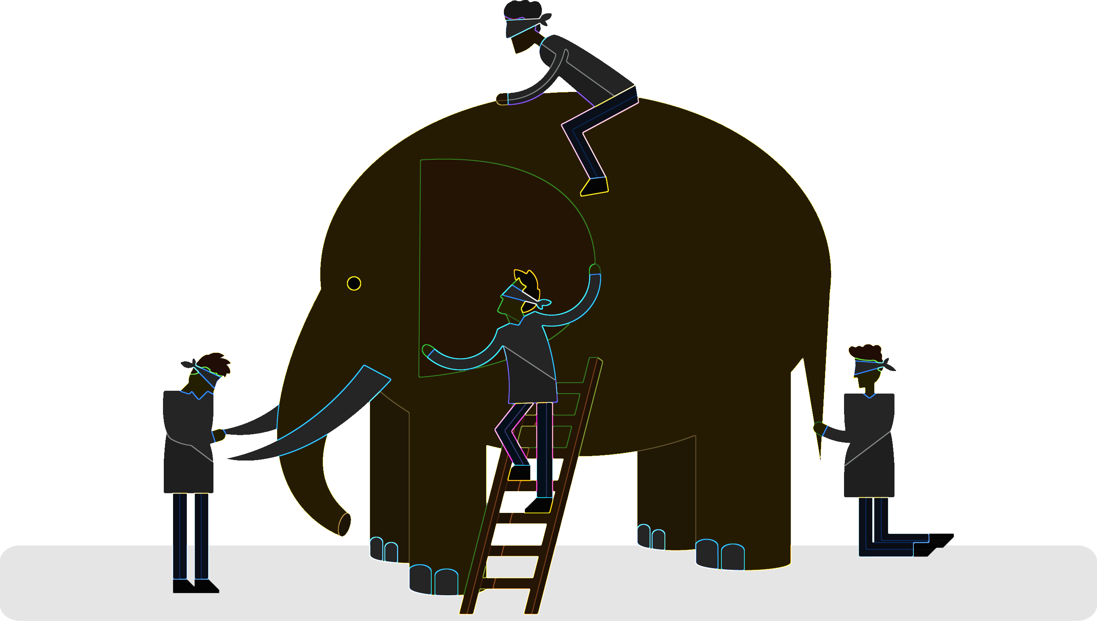
What is DevOps?
“Development and operations collaboration”
“Automation”
“Faster and smaller releases”
“A job title”
Notes:
So, what is DevOps exactly?
DevOps is a term for a group of concepts that, while not all new, have catalyzed into a movement and are rapidly spreading.
Like any new and popular term, people have different and sometimes contradictory perceptions of what it is.
Currently, DevOps is more like a philosophical movement, and not yet a precise collection of practices, descriptive or prescriptive (e.g., CMM-I, ITIL, Agile, etc.).
In his book The Phoenix Project, Gene Kim, an important DevOps influencer, describes a model how an IT organization can transition to a DevOps model to facilitate fast, rapid, reliable flow of features into production and, ultimately, into the hands of users.

Slide 130
What is DevOps?
People. Process. Products.
Build& Test
Deploy
DevOps is the union of people, process, and products to enable continuous delivery of value to your end users.
“
Continuous Delivery
Develop
Operate
”
Plan & Track
Monitor & Learn
Notes:
DevOps is the union of people, process and products to enable the continuous delivery of value to your end customers

Slide 131


High Performance DevOps Companies Achieve…
46x Deployment
Frequency
2,555x Faster Lead
Time For Changes
Faster
Time to Market
DevOps
$
Increased
Revenue
7x Lower Change
Failure Rate
2,604x Faster Mean
Time to Recover
Source: 2018 Accelerate: State of DevOps: Strategies for a New Economy." N. Forsgren, J. Humble, G. Kim. DevOps Research and Assessment (DORA)

Slide 132
DevOps vs Traditional SW Delivery
Traditional
DevOps
Waterfall methodology
Several silo teams
IT and business are divided
A couple of releases a year
Agile methodologies, often scrum
Multidisciplinary teams working together
Development, business and IT operations are one team
Several releases a day

Slide 133
How Microsoft can help
Microsoft Azure is a powerful and flexible foundation for past, present, and future apps – easily build, manage, and deploy any application and any stack on a massive, global network using your favorite tools and frameworks.
Flexible
Powerful
Open
Choice of IaaS, PaaS, public cloud or hybrid.
Mirror or modernize app infrastructure with VMs, containers, microservices or serverless.
Supports all stages of the app modernization journey – from lift-and-shift to Cloud-Native.
Instantly improve the performance, scalability and resiliency of your apps by moving them to the cloud.
Increase business agility with Cloud-Native capabilities and built-in DevOps for continuous innovation.
Bring your stack, we bring a cloud that runs any app, on any platform, and any language.
Build applications using the language and tools of your choice - Azure supports what you already use and love so you can get up and running fast – just bring code.

Slide 134
What technologies do I need to support DevOps?
DevOps brings together people, processes, and technology, automating software delivery to provide continuous value to your users. Using Azure DevOps, you can deliver software faster and more reliably - no matter how big your IT department or what tools you’re using.
Continuous Integration (CI)
Improve software development quality and speed.
When you use Azure Pipelines or Jenkins to build apps in the cloud and deploy to Azure, each time you commit code, it’s automatically built and tested and bugs are detected faster.
Continuous Deployment (CD)
By combining continuous integration and infrastructure as code (IaC), you’ll achieve identical deployments and the confidence to deploy to production at any time.
With continuous deployment, you can automate the entire process from code commit to production if your CI/CD tests are successful.
Continuous Learning & Monitoring
With Azure Application Insights you can identify how your applications are performing and test if the recent deployment made things better or worse.
Using CI/CD practices, paired with monitoring tools, you’ll be able to safely deliver features to your customers as soon as they’re ready.

Slide 135
CI vs CS
Continuous integration (CI) | Continuous delivery (CD)
Increase code coverage. | Automatically deploy code to production.
Build faster by splitting test and build runs. | Ensure deployment targets have latest code.
Automatically ensure you don't ship broken code. | Use tested code from CI process.
Run tests continually.

Slide 136





What is Azure DevOps?
Azure DevOps provides developer services to support teams to plan work, collaborate on code development, and build and deploy applications. Developers can work in the cloud using Azure DevOps Services or on-premises using Azure DevOps Server, formerly named Visual Studio Team Foundation Server (TFS). Azure DevOps provides an integrated set of features that you can access through your web browser or IDE client. You can acquire one or more of the following services based on your business needs:
Azure Repos
Azure Boards
Azure Artifacts
Azure Pipelines
Azure Test Plans

Slide 137
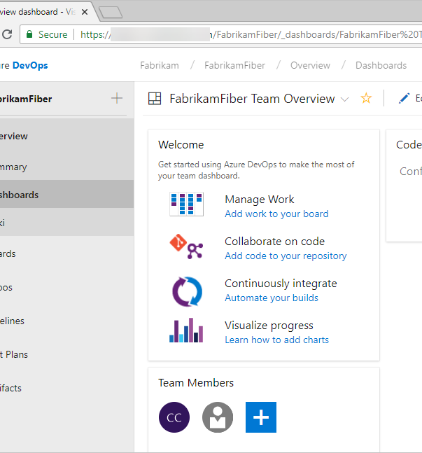
Dashboards
You can do the following tasks in Dashboards:
Add, configure, and manage dashboards
Configure widgets that you add to dashboards
Quickly navigate to different areas of your project

Slide 138
with Azure DevOps
Deliver
Azure Boards
Azure Repos
Azure Pipelines
Azure Artifacts
Azure Test Plans

Slide 139
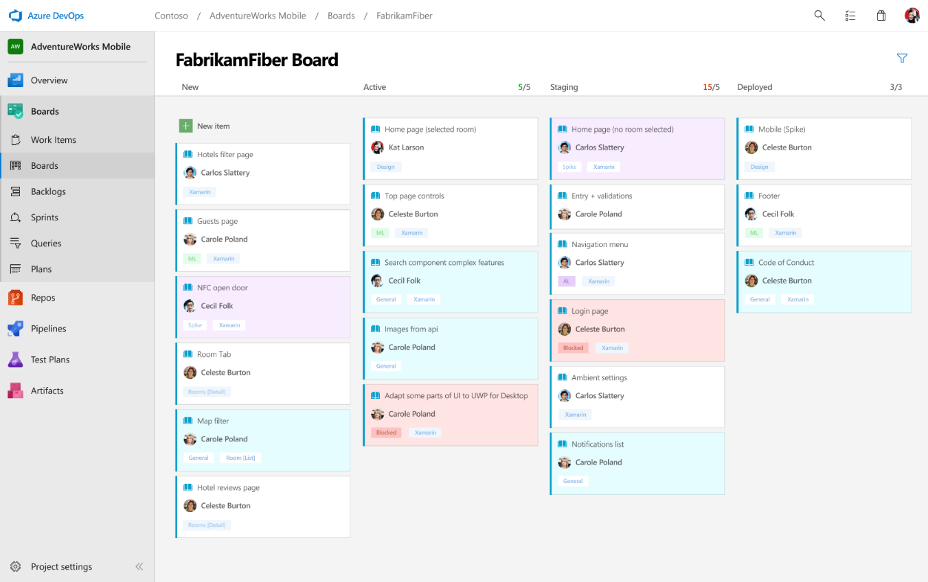
Deliver
Azure Boards
Azure Repos
Azure Pipelines
Connecting ideas to releases
Scrum ready to help your teams run sprints, stand-ups, and plan work
Integrated with GitHub commits and pull requests
Insights into project status and health
Azure Artifacts
Azure Test Plans

Slide 140
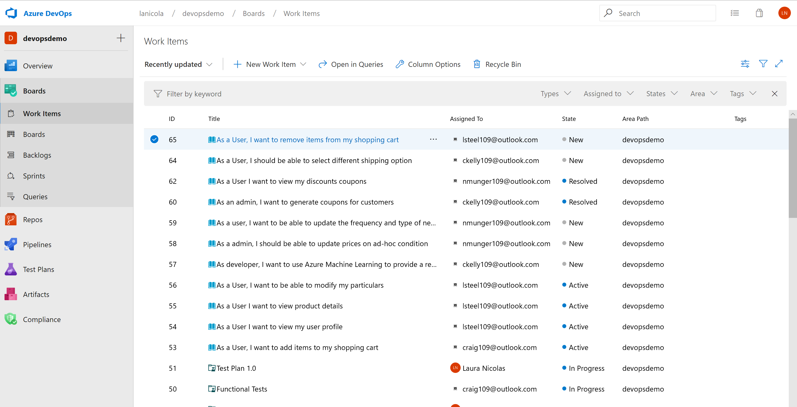
Boards
Create a collaboration environment
Software development projects require ways to easily share information and track the status of work, tasks, issues, or code defects.
Our systems provide several types of work items that you use to track features, requirements, user stories, tasks, bugs, and issues.
In Boards we support several agile methods: Scrum, Kanban, or Scrumban.

Slide 141
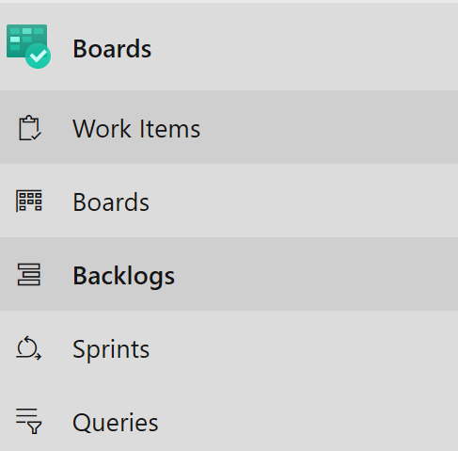
Kanban Boards
Work Items
Boards: shows work items as cards and support quick status updates through drag-and-drop. The feature is similar to sticky notes on a physical whiteboard. Use to implement Kanban practices and visualize the flow of work for a team.
Backlogs: shows work items as lists. A product backlog represents your project plan and a repository of all the information you need to track and share with your team.
Sprints: Sprint backlogs and taskboards provide a filtered view of work items a team assigned to a specific iteration path, or sprint. From your backlog, assign work to an iteration path by using drag-and-drop. You can then view that work in a separate sprint backlog. Use to implement Scrum practices.
Queries: Queries are filtered lists of work items based on criteria that you define by using a query editor.
Work items: Quickly find work items assigned to you or pivot or filter work items based on other criteria, such as work items that you follow, that you're mentioned in, or that you viewed or updated.

Slide 142
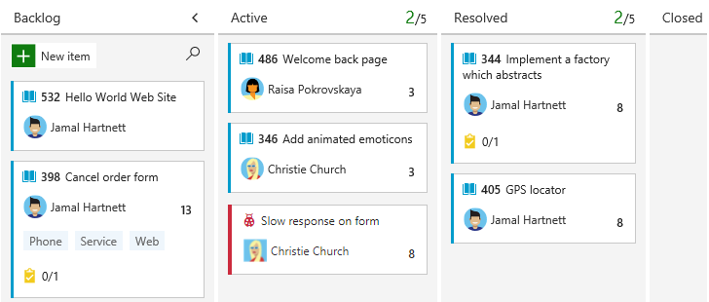
Boards
Your Kanban board turns your backlog into an interactive signboard, which provides a visual flow of work. As work progresses from idea to completion, you update the items on the board. Each column represents a work stage. Each card represents a backlog item, user story, or bug at that stage of work.

Slide 143
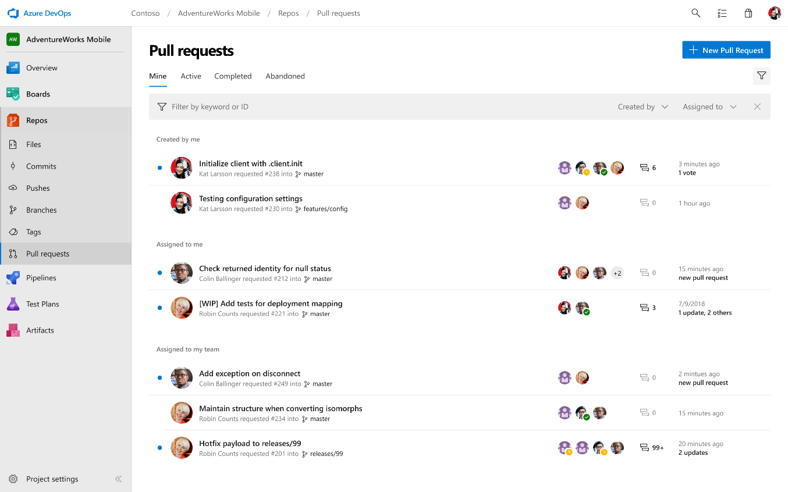
Deliver
Azure Boards
Azure Repos
Azure Pipelines
Private Git and TFVC repos for your teams
Code review via branch pull requests
Branch policies and build validation
Easy migration path to / from GitHub
Azure Artifacts
Azure Test Plans

Slide 144
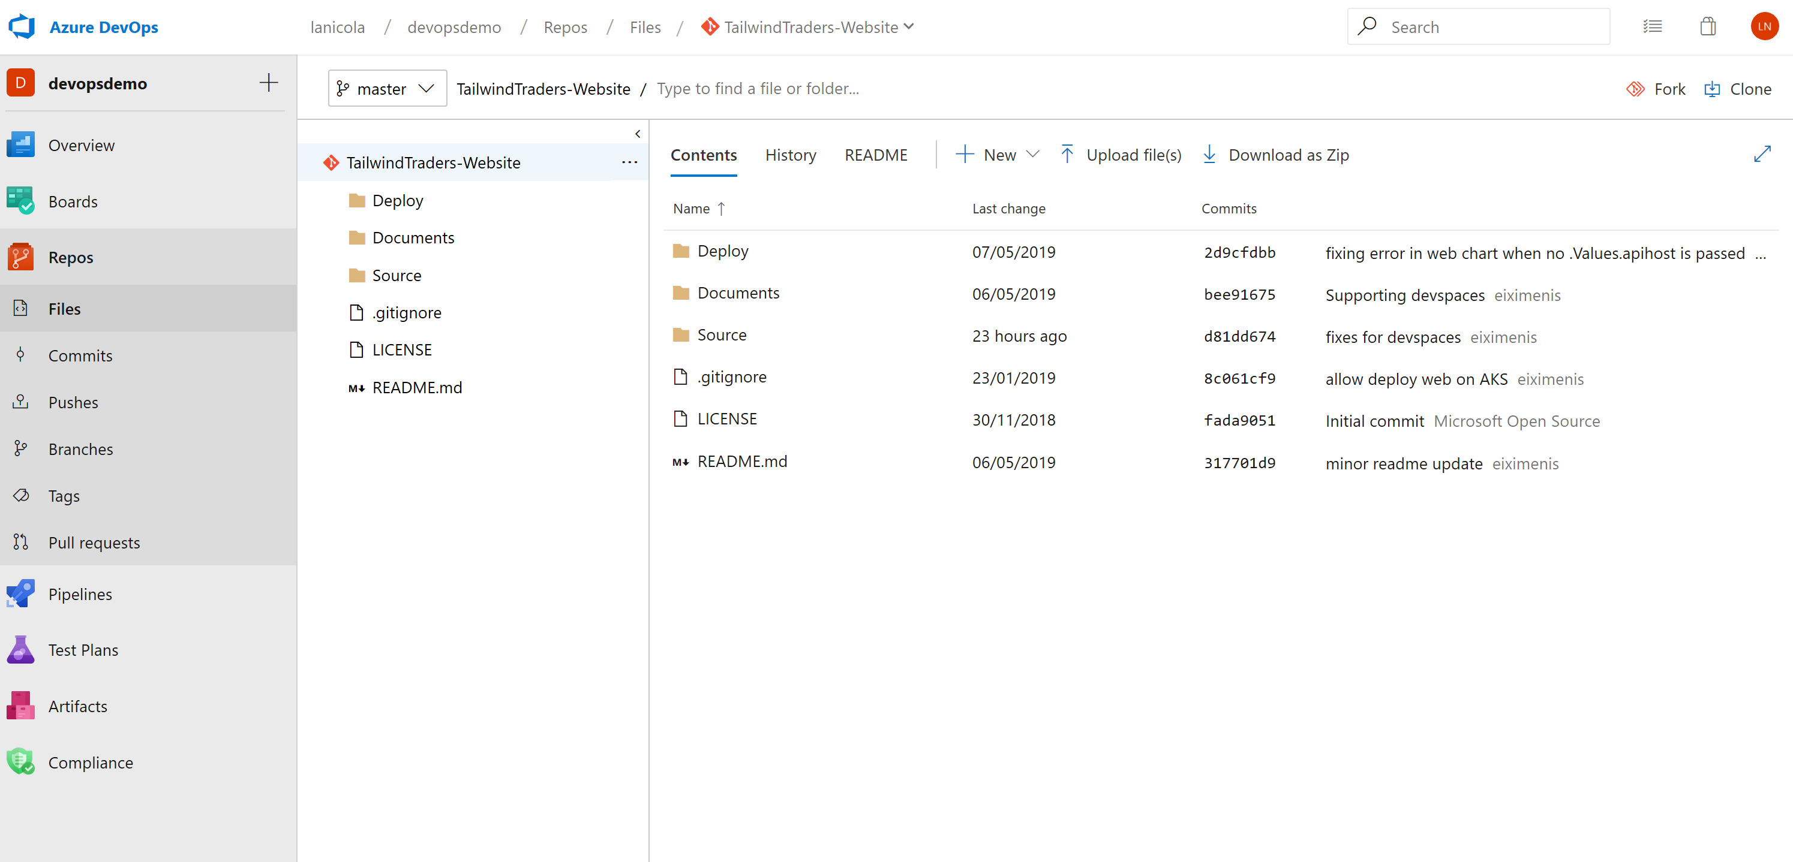
Azure Repos
Source control systems allow developers to collaborate on code and track changes made to the code base. Supports two types of source control:
Git
Team Foundation Version Control
Git in Azure DevOps is standard Git. You can use Visual Studio with third-party Git services. You can also use third-party Git clients with Azure DevOps Server.
Private Git and TFVC repos for your teams
Code review via branch pull requests
Branch policies and build validation
Easy migration path to / from GitHub

Slide 145
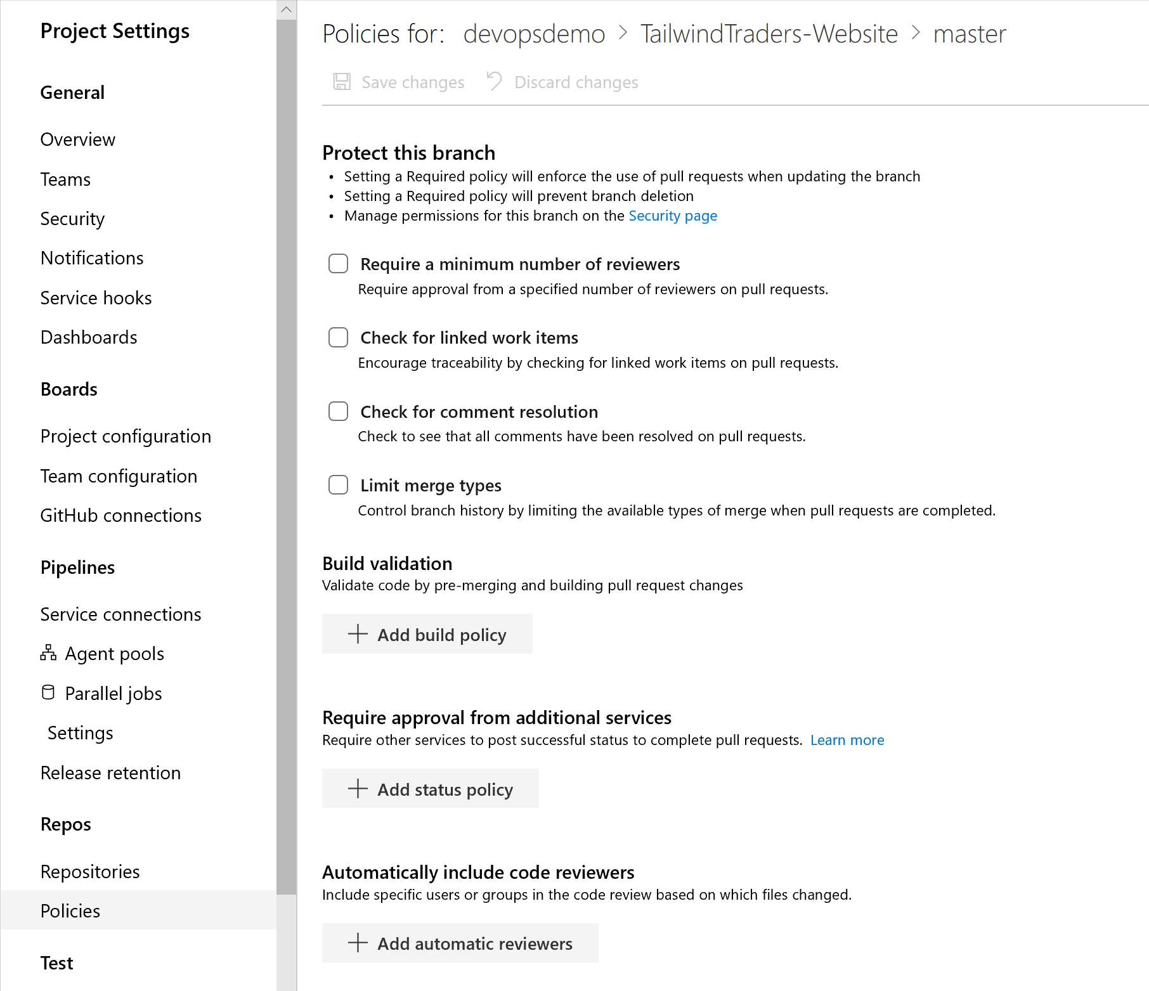
Working with Git in Azure DevOps
From Azure Repos for Git, you can do the following tasks:
Review, download, and edit files, and review the change history for a file
Review and manage commits that have been pushed
Review, create, approve, comment on, and complete pull requests
Add and manage Git tags
Enable Branch policies so you can:
Enforce the use of pull requests when updating the branch
Prevent branch deletion
Require approval from a specified number of reviewers on pull requests
Encourage traceability by checking for linked work items on pull requests
Require other services to post successful status to complete pull requests.

Slide 146
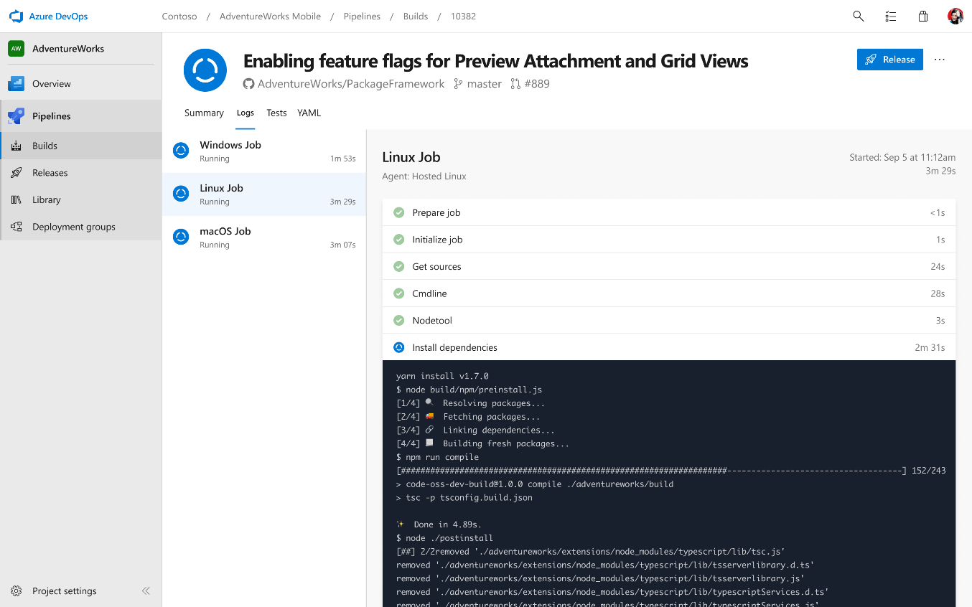
Deliver
Azure Boards
Azure Repos
Azure Pipelines
Cloud-hosted pipelines for Linux, macOS and Windows
Any language, any platform, any cloud
Native support for containers and Kubernetes
Best-in-class for open source
Azure Artifacts
Azure Test Plans

Slide 147
Build Automation
Continuous integration
Deployment Automation
Continuous Delivery
Traceability and Compliance
Hooks and Integration
Azure Pipelines

Slide 148
Azure Pipelines
In Azure DevOps you can create 2 types of pipelines
Build Pipeline
Use to create test and package source code and deliver artifacts
Define the steps to take during build and the triggers that start a build
Can include instructions to run tests after the build runs
Release Pipelines
Manages the deployment of your software builds to staging or production environments.
You can configure release pipelines that represent your environments from development to production.
Run automation to deploy your app to each environment.
Add approvers to confirm that the app has been successfully deployed in an environment.
Create your release manually or automatically from a build.

Slide 149
Azure Pipelines Concepts
Agents
To build your code or deploy your software using Azure Pipelines you need at least one agent. As you add more code and people, you'll eventually need more.
When your pipeline runs, the system begins one or more jobs. An agent is installable software that runs one job at a time.
Jobs can be run directly on the host or in a container.
Jobs
You can organize your pipeline into jobs. Every pipeline has at least one job. A job is a series of steps that run sequentially as a unit. In other words, a job is the smallest unit of work that can be scheduled to run.
Tasks
Are the steps that are taken for every job, you can use Azure DevOps tasks or use prebuild tasks from the market place.

Slide 150

Deliver
Azure Boards
Azure Repos
Azure Pipelines
Manage all package types
Add packages to any pipeline
Share code efficiently
Track external sources
Azure Artifacts
Azure Test Plans

Slide 151

Deliver
Azure Boards
Azure Repos
Azure Pipelines
Run tests and log defects from your browser
Track and asses quality throughout your lifecycle
Capture rich data for reproducibility
Create tests directly from exploratory sessions
Azure Artifacts
Azure Test Plans

Slide 152

Deliver with
Azure Boards
GitHub brings the premier social coding workflows to your team, breaking down silos and enabling Inner Source through:
Expertise sharing
Cross-team collaboration
Improved code reuse
Increased velocity
Azure Repos
Azure Pipelines
Azure Artifacts
Azure Test Plans

Slide 153

The #1 developer community on the planet
Most contributions 1.1B in 2018
Most developers 33M
Highest growth 8M new devs in 2018
Most Repos 96M
Most activity 200M PRs, 800M API requests daily
Most students 1.1M
Most organizations 2.2M
Most secure 5M vulnerability alerts in 2018
Notes:
In fact, Github is the #1 developer platform on the planet
GitHub has long been known as the home of the largest open source community in the world and it continues to grow.
In 2018, open source developers made more than 1.1 billion updates to 96 million repositories on GitHub.
GitHub’s dominance in open source is the result of their intense focus on developers.
Developers choose GitHub because it focuses on providing the best possible environment for building code, whether that’s alone or together.
GitHub allows hundreds, even thousands, of developers to contribute to the same code base without fear of losing or overwriting work.
After seeing the successful projects being built in the open source communities, organization of all shapes and sizes took notice.
Today, GitHub is meeting the demands of some of the most challenging business environments, including highly regulated industries from automotive and finance, to farming and medicine.

Slide 154








Home to the most important and popular open source projects on the planet
Notes:
GitHub is also home to the most important and popular open source projects on the planet
From the Linux kernel itself, Kubernetes and through to today’s most popular languages and frameworks such as Go, Angular, React and .NET core
With almost all IT solutions these days taking a dependency on open source projects, it’s likely that these projects live on GitHub.
This makes GitHub, the best place for your company to participate in these projects, even if it’s just keeping your finger on the pulse or the ability to raise issues

Slide 155



Azure DevOps Integrated with GitHub
Rich integration with Azure Pipelines and Azure Boards

Slide 156
Working with Azure DevOps
When working with Azure DevOps there are 2 possible options:
Azure DevOps Service
The cloud offering that provides a scalable, reliable, and globally available hosted service.
It's backed by a 99.9% SLA, monitored by our 24/7 operations team, and available in local data centers around the world.
Azure DevOps Server
Is the on-premises offering that's built on a SQL Server back end
In cases when you need your data to stay within their network or when you want access to SQL Server reporting services that integrate with Azure DevOps data and tools.
There are some differences in the offerings, Azure DevOps Services doesn't support integration with SQL Server Analysis Services to support reporting; however, it has simplified management, immediate access to new featured, improved global connectivity and transitions from CapEx to OpEx.

Slide 157
Azure DevOps
Better together
Azure Boards
Azure Repos
Azure Pipelines
Azure Test Plans
Azure Artifacts
An end-to-end solution for organizations looking for an enterprise-grade toolchain
Fully Integrated with end to end traceability
Scalable to any team and project size
Highly available, multi region, hybrid cloud & on-prem
Customer Support
Consistent admin and access control

Slide 158













Broadening the Azure Ecosystem
Notes:
So does TFS

Slide 159















Azure DevOps: Choose the tools and clouds you love
Azure DevOps lets developers choose the tools that are right for them
Mix and match to create workflows with tools from Microsoft, open source or your favorite 3rd party tools
Target any cloud, on-prem or both and deploy to the servers you need

Slide 160
DevOps at Microsoft
Azure DevOps is the toolchain of choice for Microsoft engineering with over 90,000 internal users
➔
https://aka.ms/DevOpsAtMicrosoft
372k
Pull Requests per month
4.4m
Builds per month
5m
Work items viewed per day
78,000
Deployments per day
2m
Git commits per month
500m Test executions per day
500k
Work items updated per day
Data: Internal Microsoft engineering system activity, August 2018
Notes:
Enterprise scale

Slide 161



Continuous Security
Azure Security Center
Gain full visibility and control of your cloud security state
Leverage ML to Proactively identify and mitigate risks to reduce exposure to attacks
Quickly detect and respond to threats with advanced analytics
Notes:
Just because you’re moving fast, doesn’t mean you have to lose control – even if you have some Shadow-Ops happening
Azure security gives you visibility and control of your entire cloud security state
Using analytics to provide pro-active recommendations across both Windows and Linux
Leverage services like Azure Event Viewer also to track access, see who change what and when.
------ (additional product context) ------
Secure your cloud resources with Azure Security Center
With Azure Security Center you can gain full visibility and control of your cloud security state with a single, unified view:
Collect security data from multiple sources: Collect, search, and analyze security data from a variety of sources, including connected partner solutions like network firewalls and other Microsoft services.
Integration with existing security workflows: Access, integrate, and analyze security information using REST APIs to connect existing tools and processes.
Easily onboard cloud resources: Keep pace with rapidly changing cloud workloads. Automatically discover and onboard new resources created in your Azure subscriptions.
Continuous security assessment: monitor the security of virtual machines, networks, and Azure services using hundreds of built-in security assessments or create your own.
Built-in dashboards provide instant insights into security issues that require attention.
Centralized policy management: Ensure compliance with company or regulatory security requirements by centrally managing security policies across all your cloud workloads.
Compliance reporting: Use security data and insights to demonstrate compliance and easily generate evidence for auditors.
(If asked whether Azure Security Center supports hybrid workloads, the answer is yes: manage security across all your hybrid cloud workloads – on-premises, Azure, and other cloud platforms – in one console.)
You can also identify and mitigate risks proactively to reduce your exposure to security threats:
Proactive security assessment: Identify software and configurations that are vulnerable to attack.
Actionable recommendations: Remediate security vulnerabilities before they can be exploited by attackers with prioritized, actionable security recommendations and built-in automation playbooks.
Adaptive application controls: Block malware and other unwanted applications by applying whitelisting recommendations adapted to your specific workloads and powered by machine learning.
Controlled network access: Reduce the network attack surface with just-in-time, controlled access to management ports on Azure VMs, drastically reducing exposure to brute force and other network attacks.
Azure Security Center has robust capabilities to prevent attacks. When threats do happen, Security Center can quickly detect and respond to threats with advanced analytics and Microsoft Intelligent Security Graph.
Industry’s most extensive threat intelligence: Tap into the Microsoft Intelligent Security Graph, which uses trillions of signals from Microsoft services and systems around the globe to identify new and evolving threats.
Advanced threat detection: Use built-in behavioral analytics and machine learning to identify attacks and zero-day exploits. Monitor networks, machines, and cloud services for known attack patterns and post-breach activity.
Prioritized alerts and incidents: Focus on the most critical threats first with prioritized security alerts and incidents that map alerts of different types into a single attack campaign. Create your own custom security alerts as well.
Streamlined investigation: Quickly assess the scope and impact of an attack with a visual, interactive experience. Use predefined or ad hoc queries for deeper exploration of security data.
Contextual threat intelligence: Visualize the source of attacks on an interactive world map. Use built-in threat intelligence reports to gain valuable insight into the techniques and objectives of known malicious actors.
At Microsoft, we analyze 300 billion user authentications and check 200 billion emails for spam and malware monthly. We also have unprecedented visibility into cloud infrastructure choices, platforms and the activity therein. Such visibility has no precedent in the on-premises world.

Slide 162

Smarter Insights, Faster
Azure Monitor, Application Insights & Log Analytics
Pre-defined solutions with smart thresholds
Visualize data in intuitive and customizable dashboards
Separate the signal from the noise and accelerate root-cause analysis
Integrate your existing processes & tools like Service Now
Notes:
Azure’s monitoring solutions provide pre-defined solutions with smart thresholds and intuitive dashboards so you can start getting insights straight away
Azure Monitor provides metrics for all Azure infrastructure, building upon that you can leverage both Log Analytics and Application Insights to gain greater insights into your Infrastructure and Applications respectively – leveraging Azure to simplify this into standardized dashboards for both your Developer and your Operations teams
Spend less time separating the signal from the noise and accelerate you root cause analysis
You can also automate and integrate into your existing service desk platforms such as Service Now
------ (additional product context) ------
Monitor your cloud health with Log Analytics
Collect and store your data from any source
Easily collect, store, and analyze your systems and operational data from any source, both on-premises and in the cloud.
Collect data from a wide range of sources including virtual machines, storage accounts, activity logs, Windows, Linux Servers, Java, .NET, legacy and modern apps.
Centrally store activity logs, network logs, infrastructure metrics, app data points, diagnostics logs and alerts.
Gain deep operational insights
Understand CPU disk and memory utilization for your virtual machines.
Get a comprehensive view of applications and network dependencies across multiple virtual machines to perform root-cause analysis more quickly.
Track configuration changes, system updates, and malware status to improve security & compliance.
Visualize data in intuitive and customizable dashboards.
Find the information you need quickly using interactive queries and full-text search.
Detect, diagnose and fix issues quickly
Get notifications and alerts with rich diagnostic information so you can always stay on top of the issues.
Separate the signal from the noise and accelerate root-cause analysis across platforms using advanced analytics including machine learning algorithms.
Automate the implementation of recommended fixes so you can address issues quickly.
Integrate with customer service systems such as your ticketing tool to speed up implementation of fixes.

Slide 163




Infrastructure and Configuration as Code
Azure Resource Manager, Automation & 3rd Party Integrations
Infrastructure as Code, built-in
Azure Config & Automation
Support for 3rd party and OSS tooling such as Terraform, Ansible, Chef, Puppet & SaltStack
Notes:
Deploy repeatedly & reliably using Infrastructure as Code
Azure Resource Manager provides these capabilities for Azure out of the box, and works across Azure as well as Azure Stack
But if you’re already using 3rd party tools such as Terraform, Ansible, Chef, Puppet or SaltStack – we support those too!

Slide 164


Azure DevOps Pipelines/Projects
Simplest possible process is a release pipeline that runs init, plan, apply
Recommended approach is to run plan in the build pipeline
Allows saving the plan artifact for review before an approval step in the release plan that runs terraform apply

